Slide 1

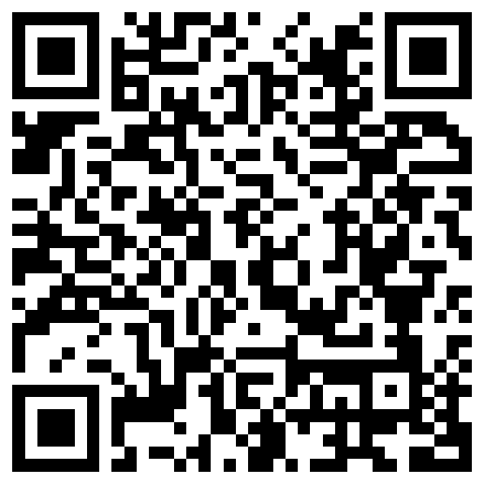
Characterizing uncertainty in lexically triggered inferences
Aaron Steven White
University of Rochester
Colloquium Talk
UCSD
18 November 2024

Slide 2
Big Question
What kinds of things do we know when we know the meaning (broadly construed) of a linguistic expression?

Slide 3
One Kind of Knowledge
How the expression can move a conversation forward when used in a particular way.

Slide 4
Leo ran the race.
Shared picture of the world

Slide 5
Did Leo run the race?
Leo ran the race.
Leo didn’t run the race.
?
?
Shared picture of the world

Slide 6
One Kind of Knowledge
How the expression can move a conversation forward when used in a particular way.
Another Kind of Knowledge
How the conversation has to look for it to even make sense to use the expression.

Slide 7


Leo ran the race.
Shared picture of the world

Slide 8
Did Leo run the race?
Leo ran the race.
Leo didn’t run the race.
?
?
Shared picture of the world

Slide 9
Surprising Fact
Sometimes we don’t seem to know whether particular expressions make sense in a certain kinds of conversation.

Slide 10
Leo won the race.
Leo ran in the race.

Slide 11
Did Leo win the race?
Did he even run in it?
?
Leo ran in the race.

Slide 12
Surprising Fact
Sometimes we don’t seem to know whether particular expressions make sense in a certain kinds of conversation.
Question
What is this uncertainty uncertainty about?

Slide 13
Possibility #1
It’s sort of like lexical ambiguity.

Slide 14
Leo ran the race.
Leo ran in the race.

Slide 15
Stride quickly
Direct activity
Leo ran the race.
?
Leo ran in the race.

Slide 16
Possibility #1
It’s sort of like lexical ambiguity.
Possibility #2
It’s sort of like vagueness.

Slide 17
Leo ran a marathon in 3:40.
?
Leo’s marathon was fast.

Slide 18
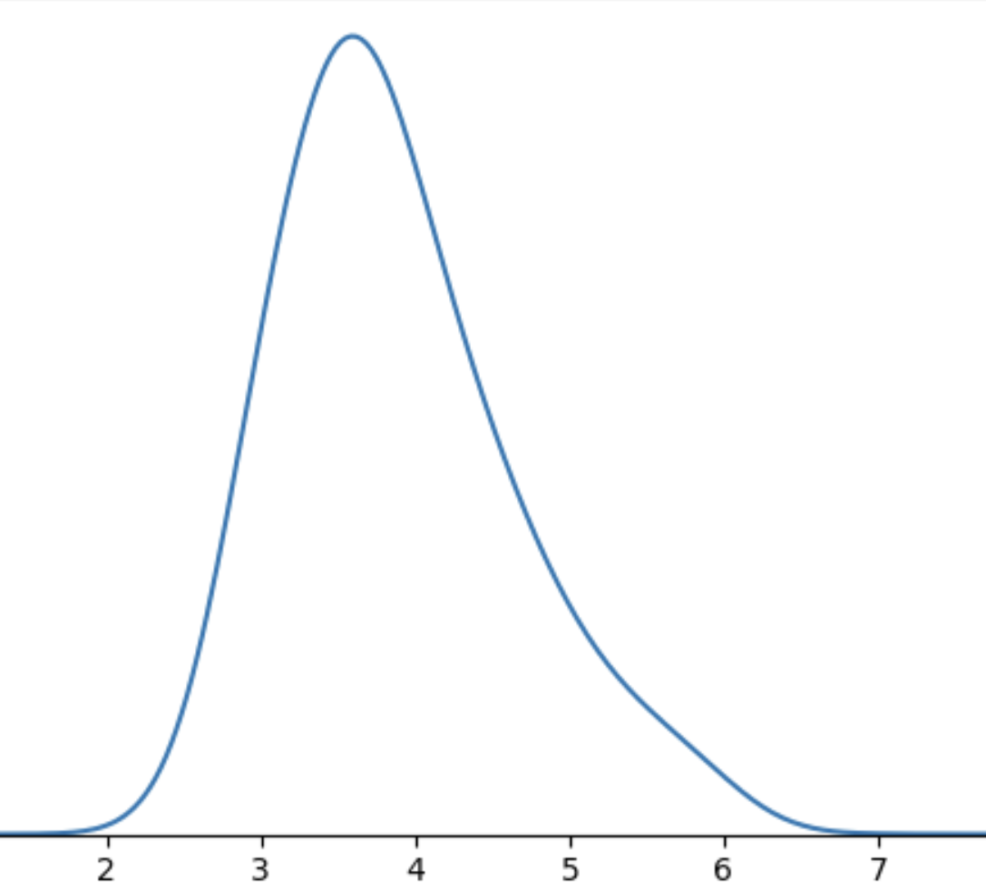
Leo’s marathon

Slide 19
Possibility #1
Resolved Uncertainty
Uncertainty about an expression and/or context of use that must be resolved on any particular occasion of use.
It’s sort of like lexical ambiguity.
Unresolved Uncertainty
Possibility #2
It’s sort of like vagueness.
Uncertainty about an expression and/or context of use that is manifest on all occasions of use.

Slide 20
Semantic + Contextual
Purely Contextual
Ambiguity
Resolved Uncertainty
Uncertainty across multiple distinct semantic values for an expression that have different preconditions of use.
Uncertainty across possible discrete states of a discourse that is resolved as a matter of integrating an utterance.
Uncertainty about the preconditions of use inherent to a single semantic value for an expression evoked on every use.
Vagueness
Unresolved Uncertainty

Slide 21
Did Leo win the race?
Leo won the race.
Leo didn’t win the race.
Leo ran in the race.

Slide 22
Did he even run in it?
Did Leo win the race?
Leo ran in the race.
?
Leo didn’t run in the race.
Leo ran in the race.

Slide 23
Semantic + Contextual
Purely Contextual
Ambiguity
Resolved Uncertainty
Uncertainty across multiple distinct semantic values for an expression that have different preconditions of use.
Uncertainty across possible discrete states of a discourse that is resolved as a matter of integrating an utterance.
Uncertainty about the preconditions of use inherent to a single semantic value for an expression evoked on every use.
Vagueness
Uncertainty across possible discrete states of a discourse that is not resolved as a matter of integrating an utterance.
Unresolved Uncertainty

Slide 24
Ideal
If we can get a purely contextual approach to work we should prefer it on parsimony grounds (all else equal).
Reason
If we can reduce some kind of knowledge to general communicative principles, we should.

Slide 25
This Talk
Expressions carry information about preconditions of use in their semantics.
Open class items are (part of) the locus of this information.

Slide 26
Case Study White & Rawlins 2018, Tonhauser et al. 2018, Degen & Tonhauser 2021, 2022, i.a.
Uncertainty about factive inferences.

Slide 27
Clause-embedding predicate
Embedded clause
Does Stacy love that Leo lost the race?
Leo lost the race
Leo lost the race.

Slide 28
Case Study
Uncertainty about factive inferences.
Reason
Class of predicates that could give rise to factive inferences–clause-embedding predicates–is large, so we can measure high-level trends across many predicates.

Slide 29
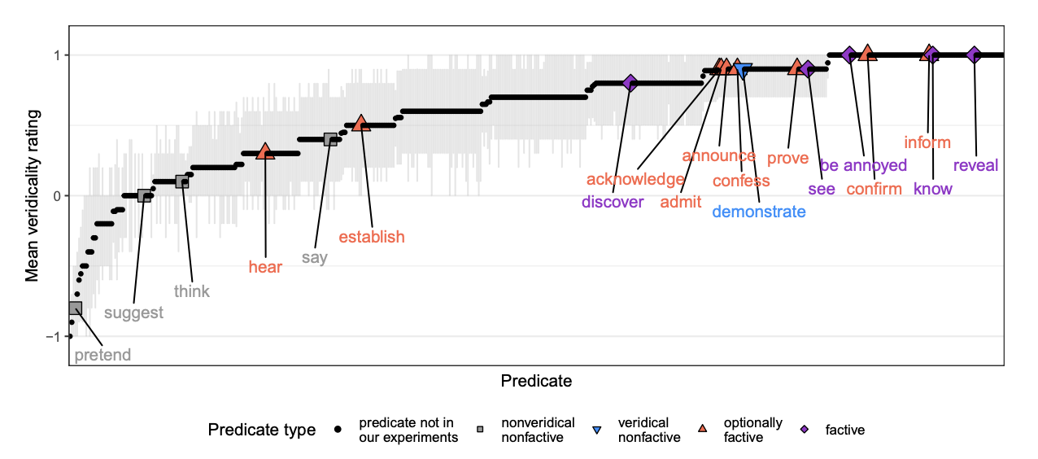
White & Rawlins 2018, White et al. 2018, Degen and Tonhauser 2022

Slide 30
Part 1
Part 2
From where does evidence for uncertainty come?
Is uncertainty about factive inferences resolved or unresolved?

Slide 31
Semantic + Contextual
Purely Contextual
Ambiguity
Resolved Uncertainty
Uncertainty across multiple distinct semantic values for an expression that have different preconditions of use.
Uncertainty across possible discrete states of a discourse that is resolved as a matter of integrating an utterance.
Uncertainty about the preconditions of use inherent to a single semantic value for an expression evoked on every use.
Vagueness
Uncertainty across possible discrete states of a discourse that is not resolved as a matter of integrating an utterance.
Unresolved Uncertainty

Slide 32
Part 1
Part 2
From where does evidence for uncertainty come?
Is uncertainty about factive inferences resolved or unresolved?
Part 3
Are factive inferences semantically encoded?

Slide 33
Semantic + Contextual
Purely Contextual
Ambiguity
Resolved Uncertainty
Uncertainty across multiple distinct semantic values for an expression that have different preconditions of use.
Uncertainty across possible discrete states of a discourse that is resolved as a matter of integrating an utterance.
Uncertainty about the preconditions of use inherent to a single semantic value for an expression evoked on every use.
Vagueness
Uncertainty across possible discrete states of a discourse that is not resolved as a matter of integrating an utterance.
Unresolved Uncertainty

Slide 34
Part 1
Part 2
From where does evidence for uncertainty come?
Is uncertainty about factive inferences resolved or unresolved?
Part 4
Part 3
Implications for semantic theory.
Are factive inferences semantically encoded?

Slide 35
Uncertainty about Factivity

Slide 36
Question
Where does evidence for uncertainty in factive inferences come from?
Answer
Aggregate measures derived from inference judgment tasks aimed at capturing projective inferences.

Slide 37
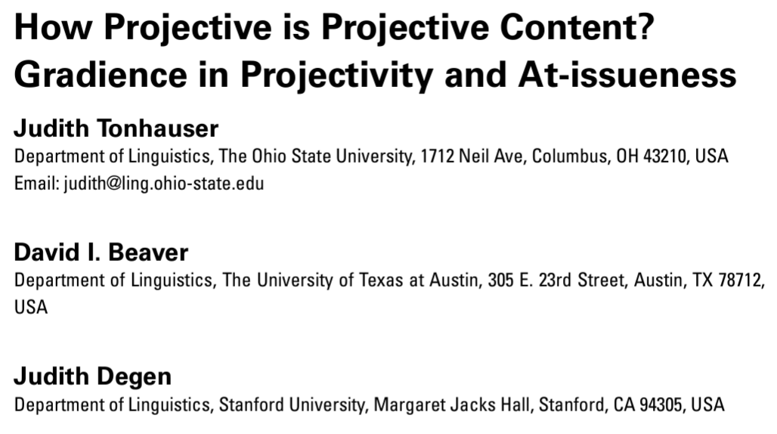
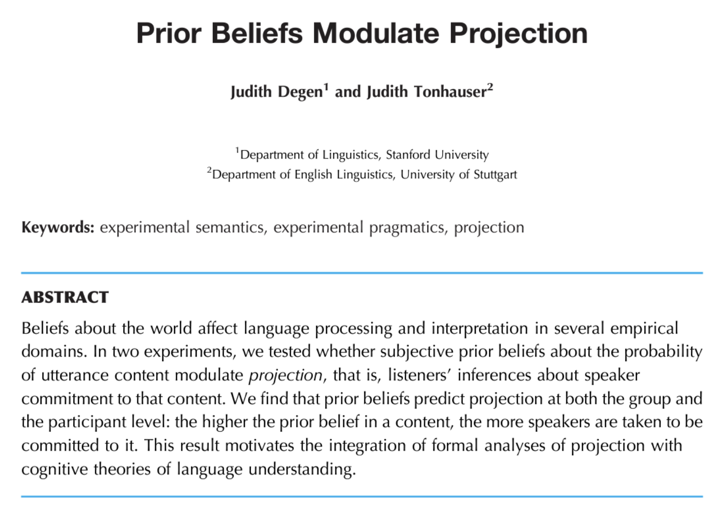
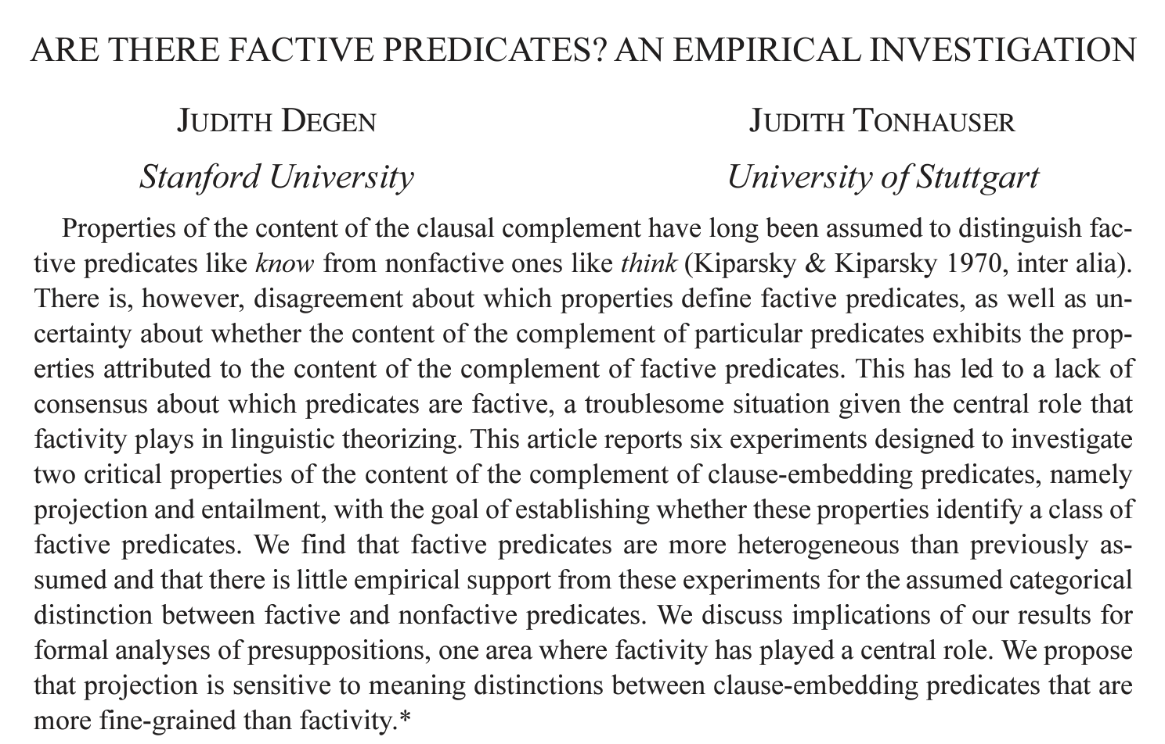

Slide 38
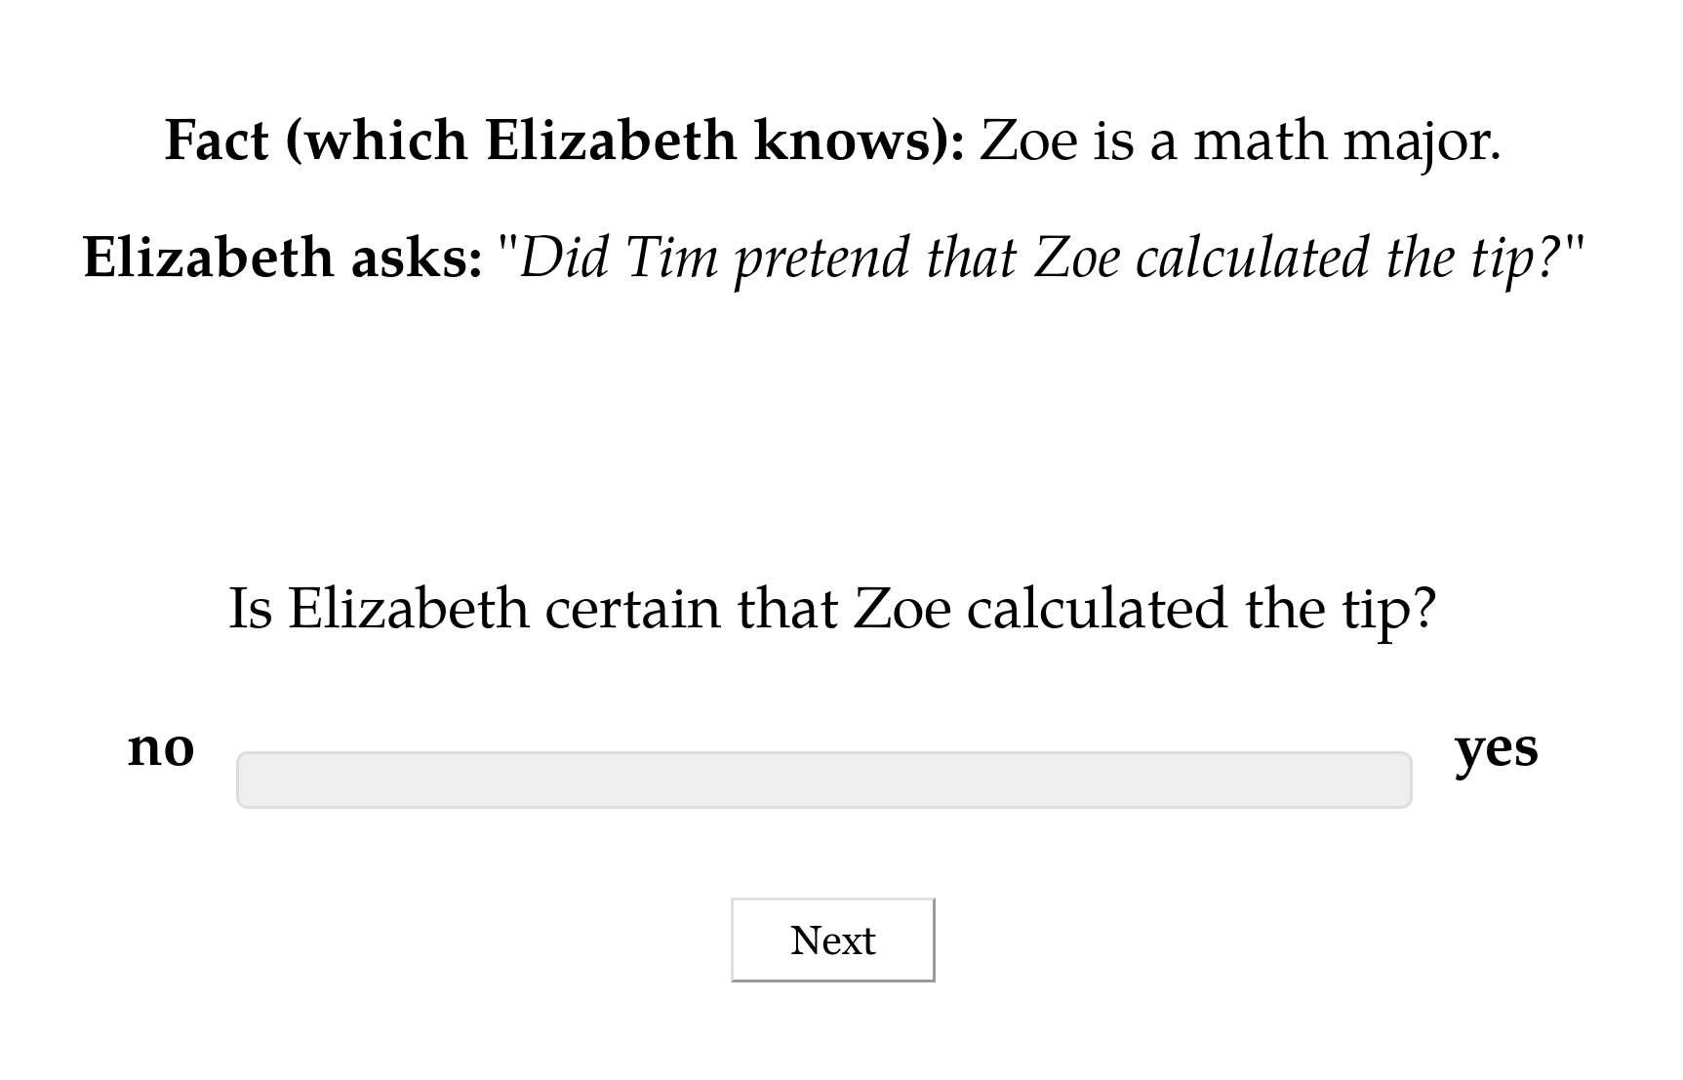

Slide 41
Norming Dataset
Measure prior knowledge: rate likelihood of proposition P given fact F.

Slide 42
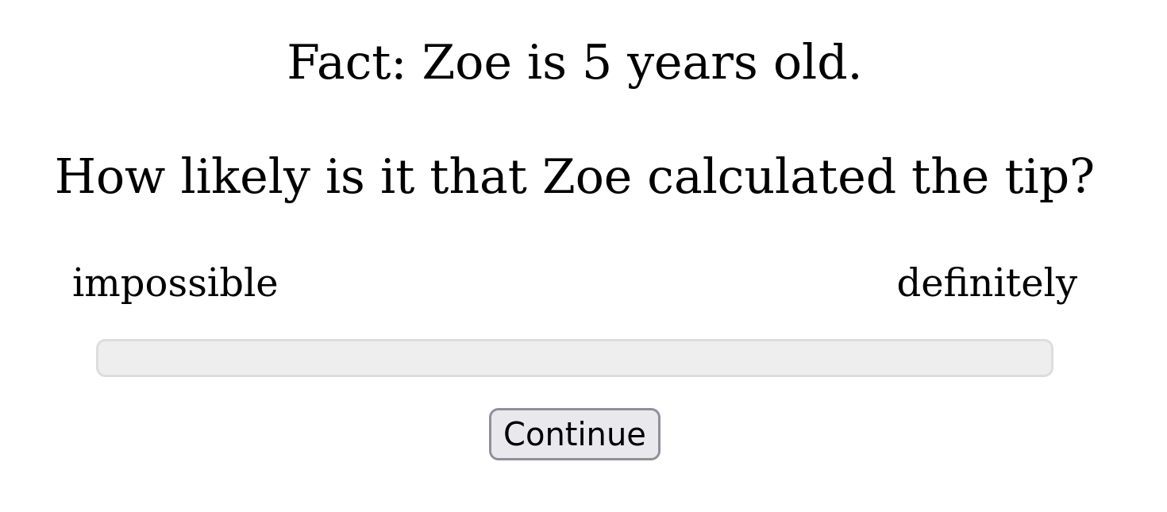

Slide 43
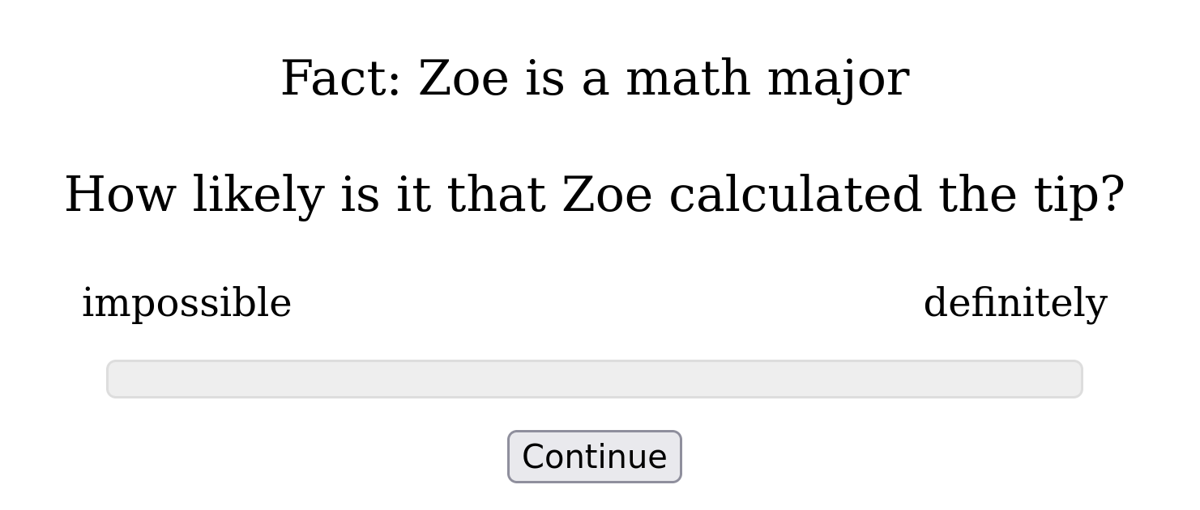

Slide 44
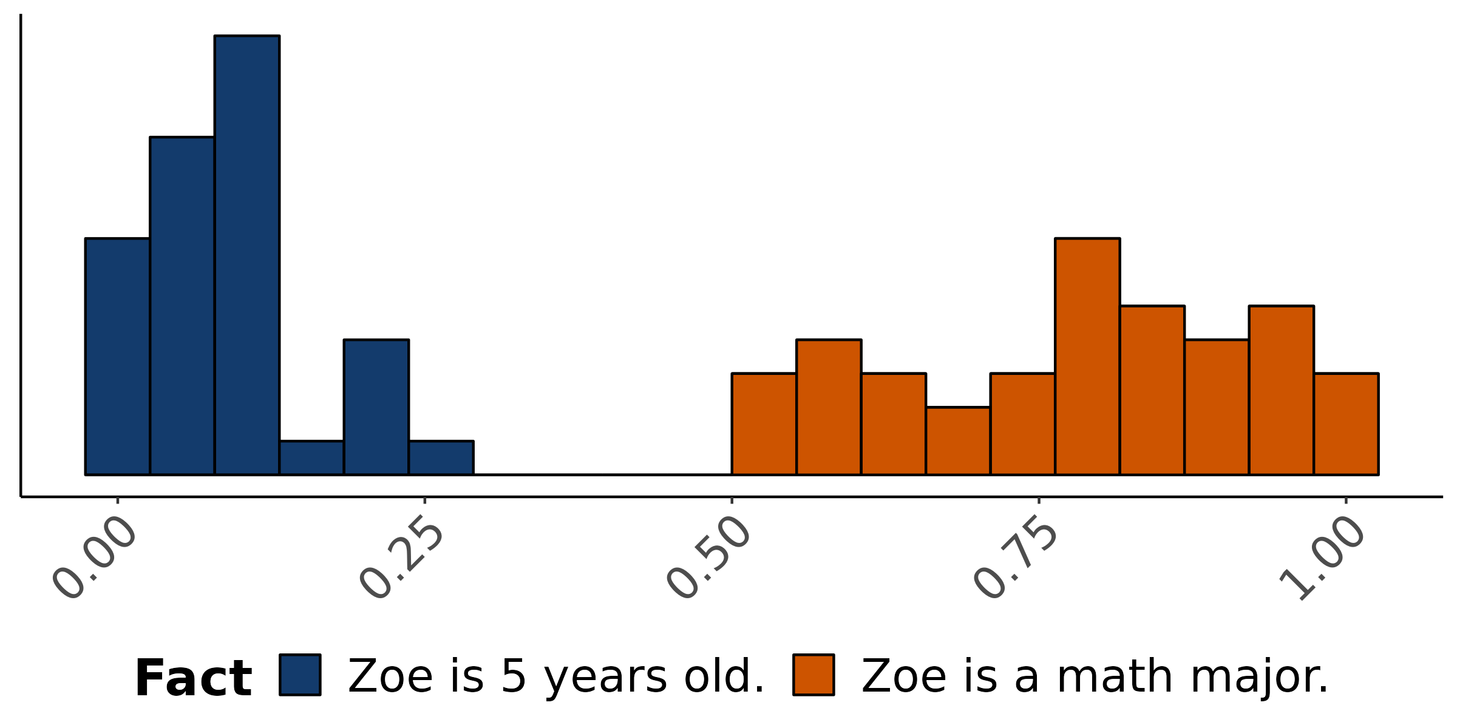
Empirical distribution of norming response
How likely is is that Zoe calculated the tip?

Slide 45
Norming Dataset
Measure prior knowledge: rate likelihood of proposition P given fact F.
Projection Dataset
Measure veridicality inferences: rate X’s certainty that P given F and a context where X asks Did/Does Y V that P?

Slide 46
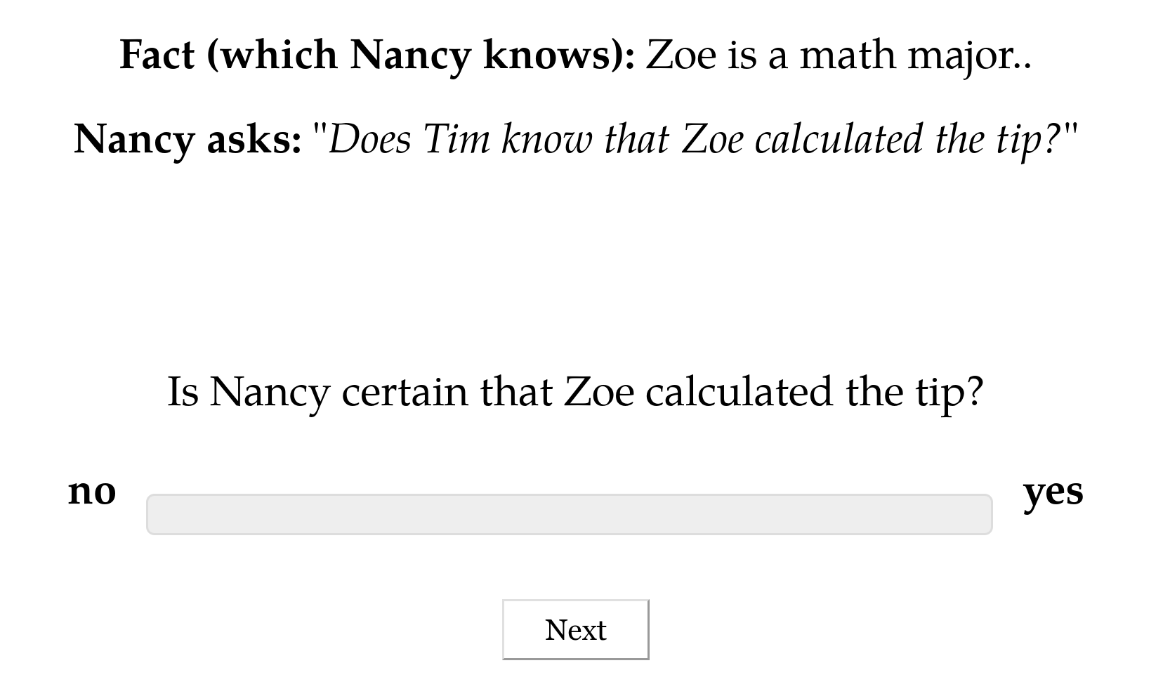

Slide 47
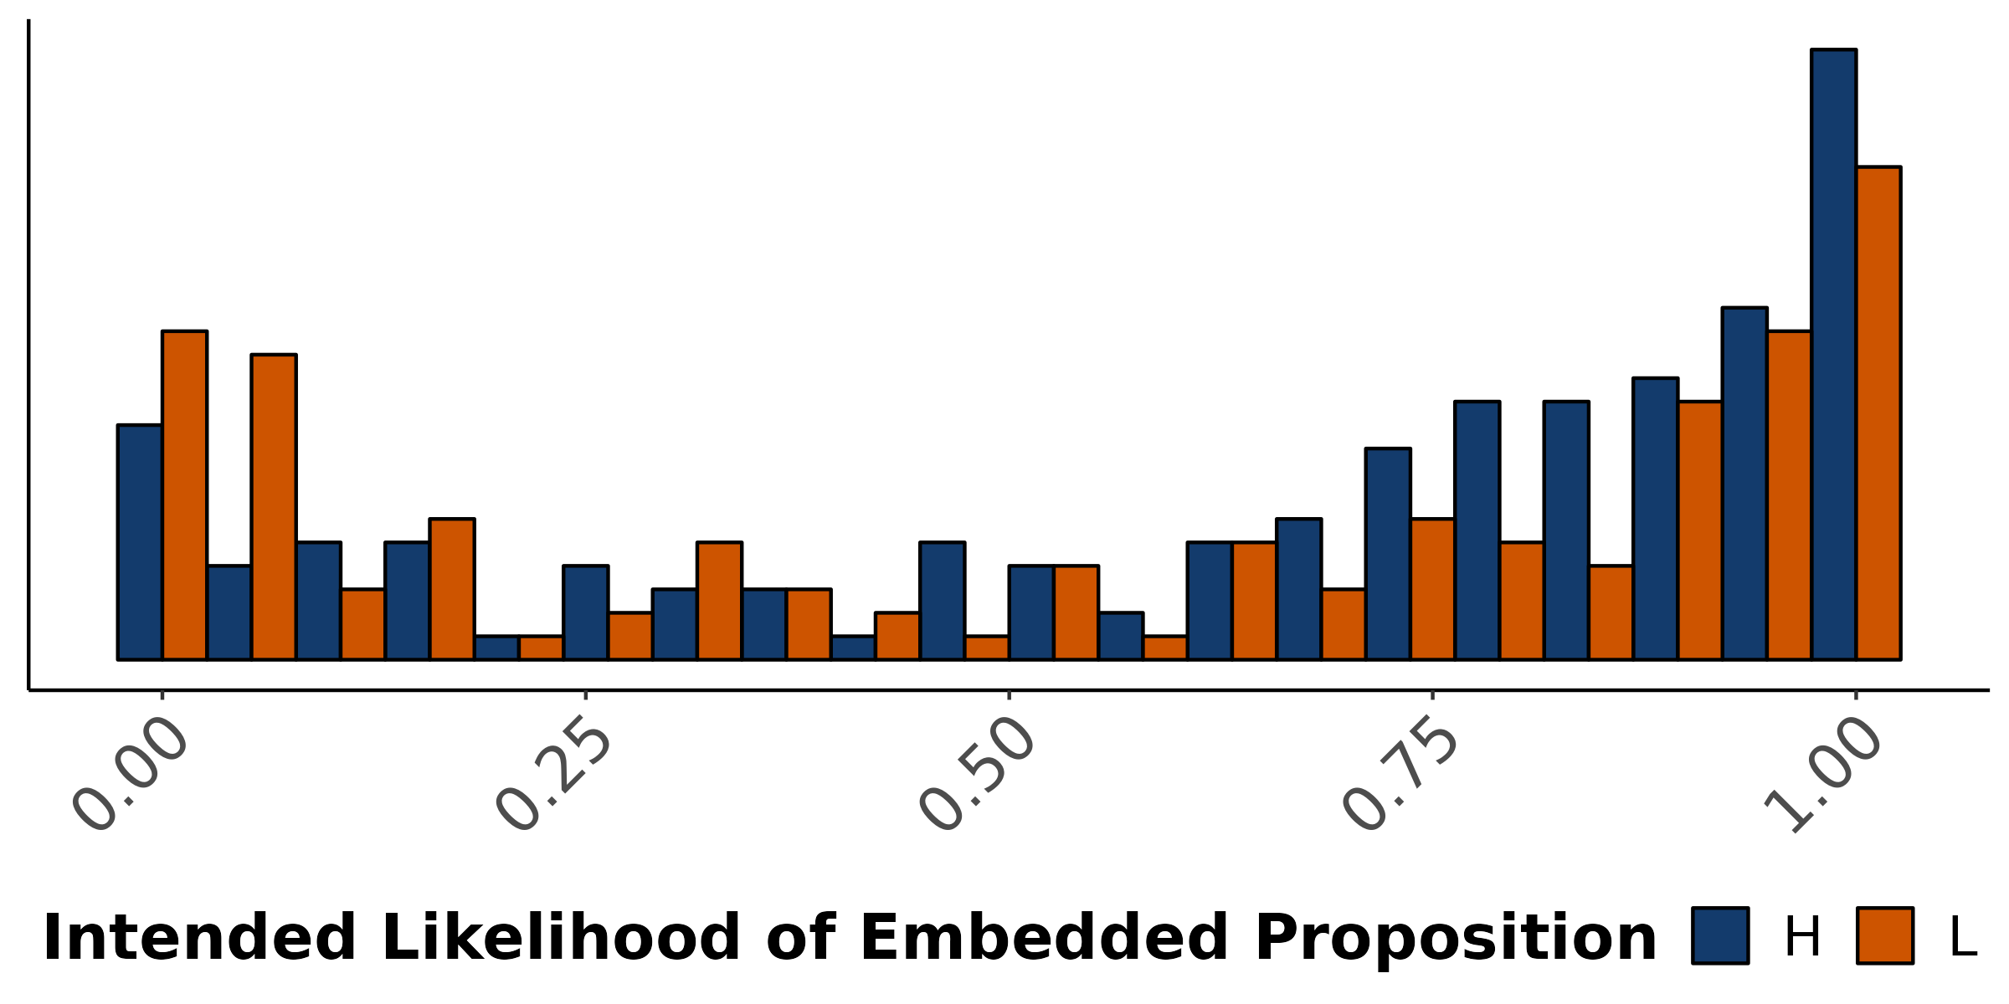
Empirical distribution of projection response
X asks: Does Y know that P?
Is X certain that P?

Slide 49
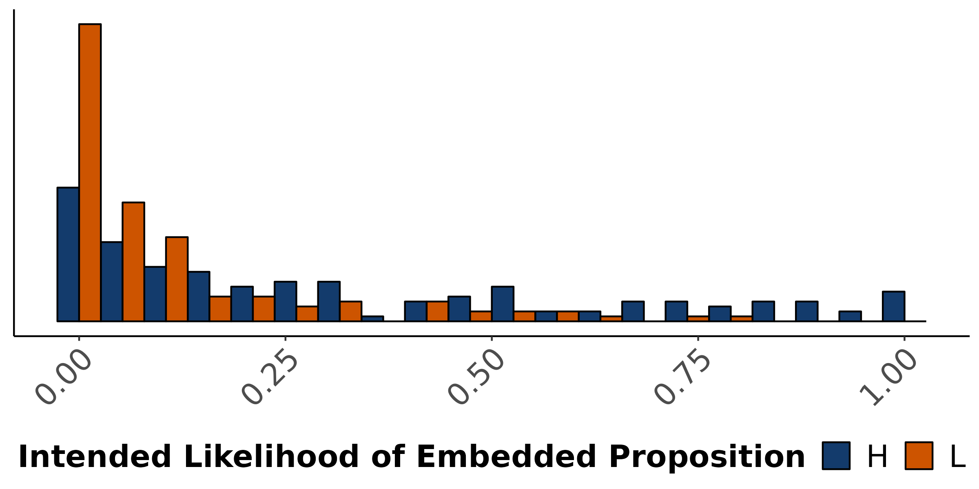
Empirical distribution of projection response
X asks: Did Y pretend that P?
Is X certain that P?

Slide 50
Resolving Uncertainty

Slide 51
Question
What do the two hypotheses about uncertainty (non)resolution predict about the distribution of judgments?

Slide 52
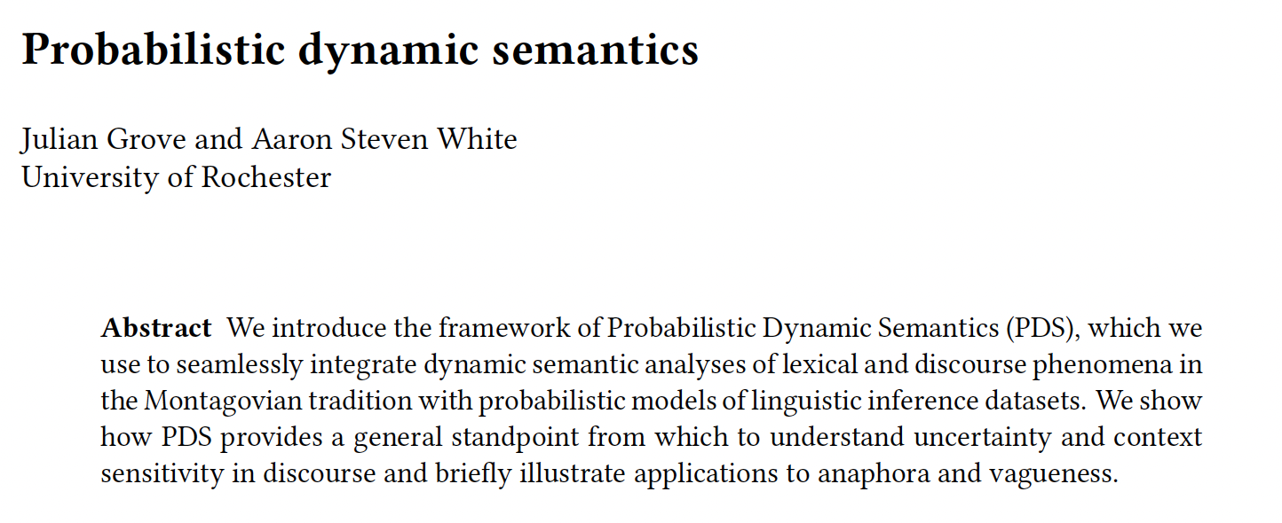
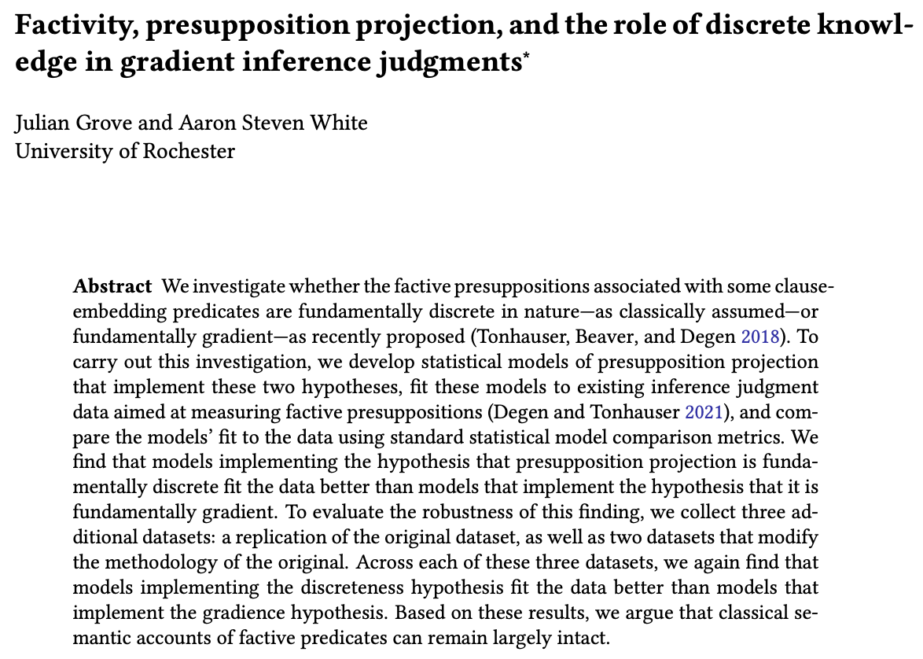
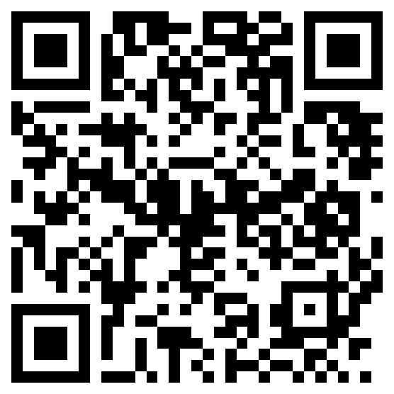
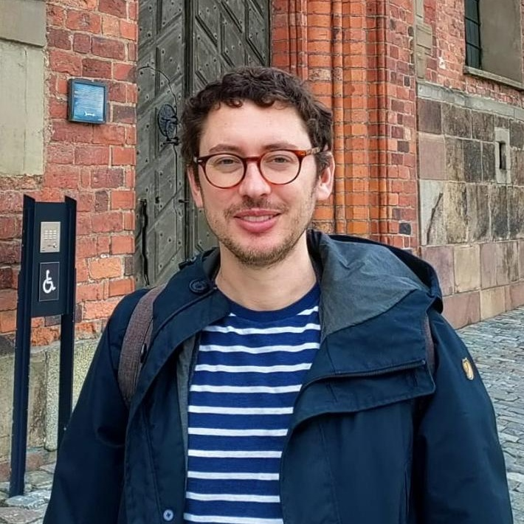
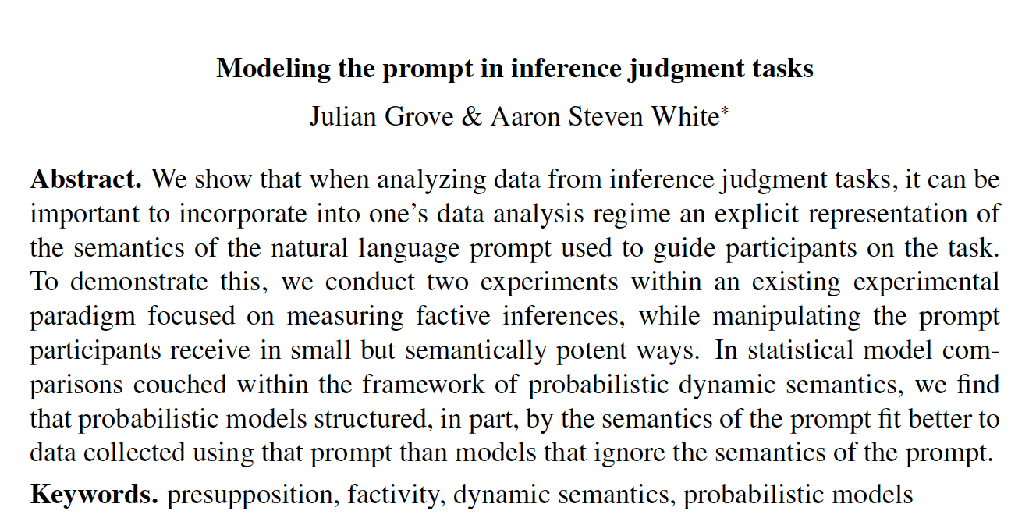
Julian Grove
University of Rochester

Slide 53
Nonresolution hypothesis
Judgments follow a single distribution whose expected value is determined by the predicate + embedded content.

Slide 54
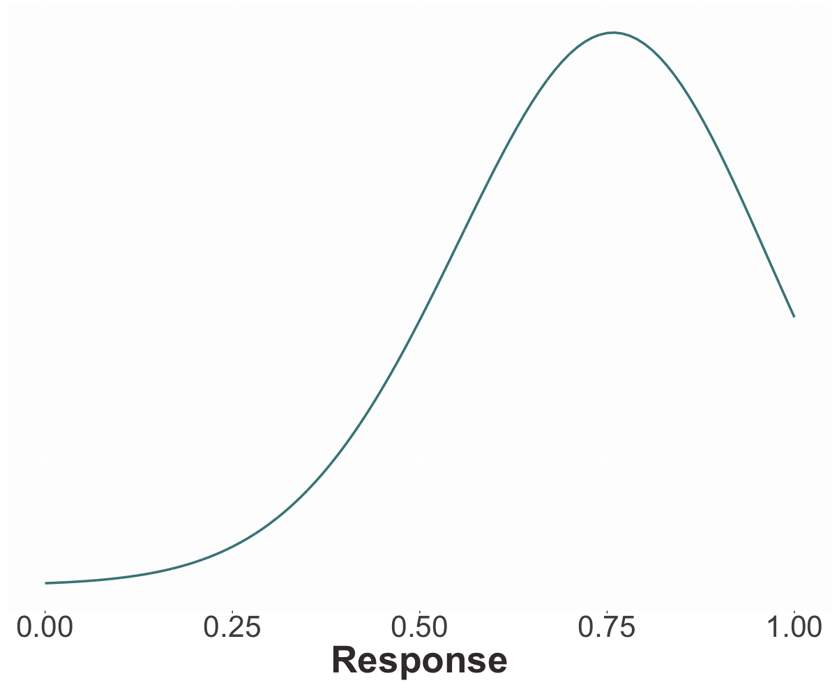
Showing truncated normal distribution but same results with ordered beta distributions!

Slide 55
Nonresolution hypothesis
Judgments follow a single distribution whose expected value is determined by the predicate + embedded content.
Resolution hypothesis
Judgments follow a mixture of three distributions: the FALSE and TRUE distributions, determined by the predicate, and the PRIOR distribution, determined by EC.

Slide 56
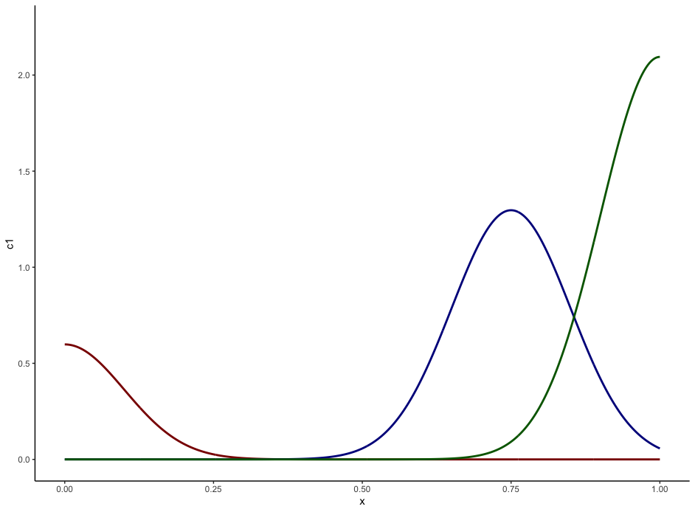
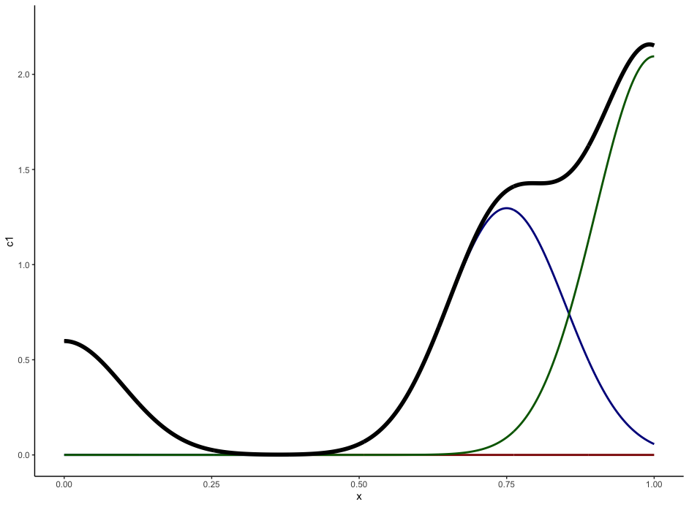
TRUE
PRIOR
FALSE

Slide 57
Method
Fit models to D&T’s norming data using MCMC and compare fits.
Fit models to D&T’s projection data using MC, with priors determined by norming fits, and compare fits.

Slide 58
Question #1
Is uncertainty about prior beliefs resolved or unresolved?

Slide 59
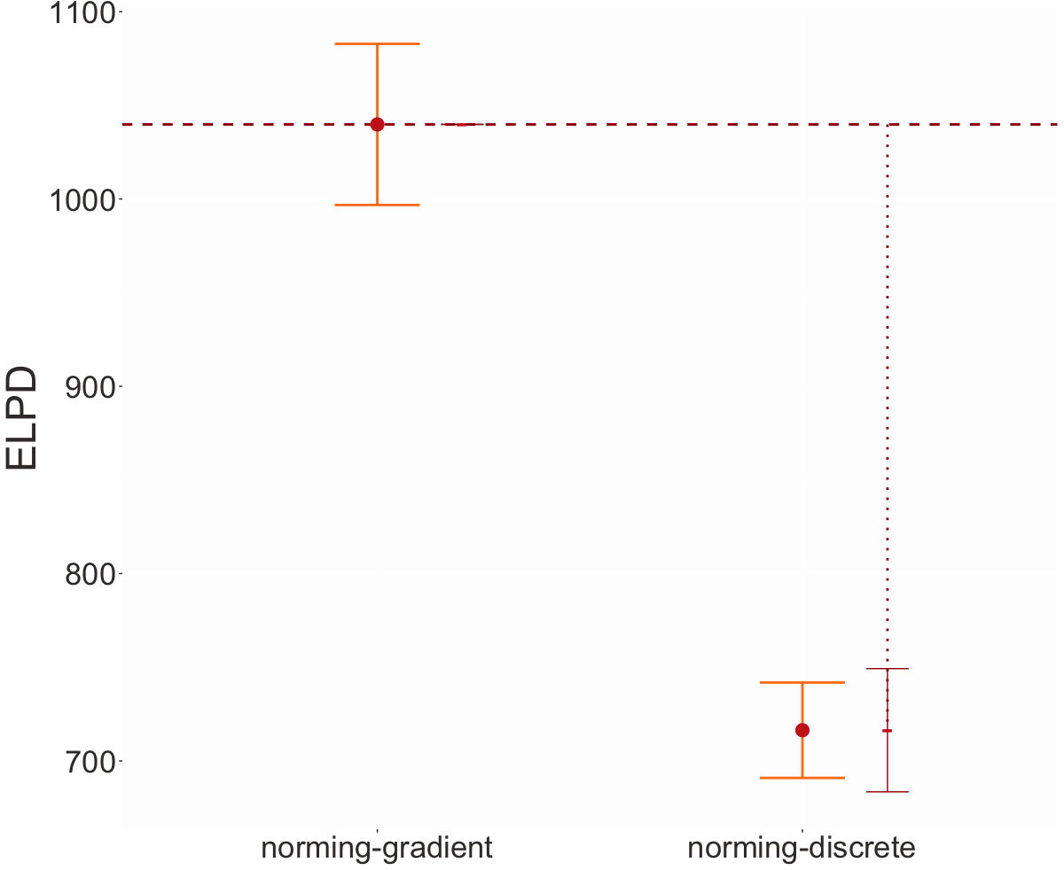
Higher means better fit
Uncertainty about prior beliefs is unresolved.
Unresolved
Resolved

Slide 60
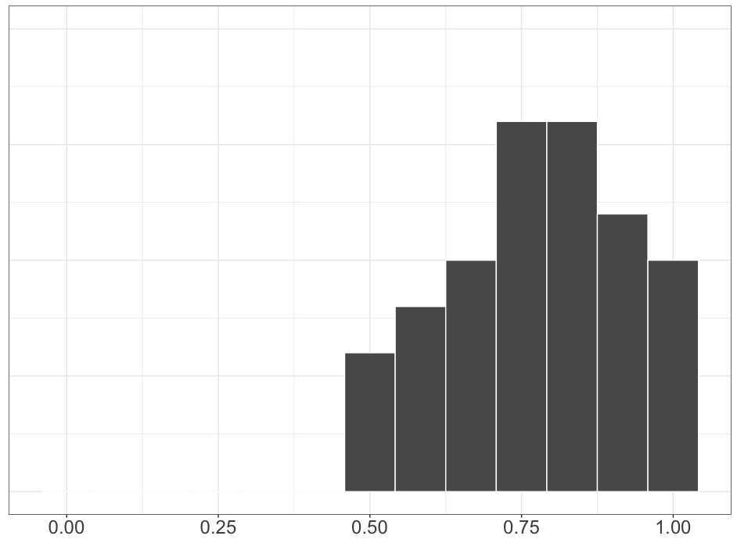
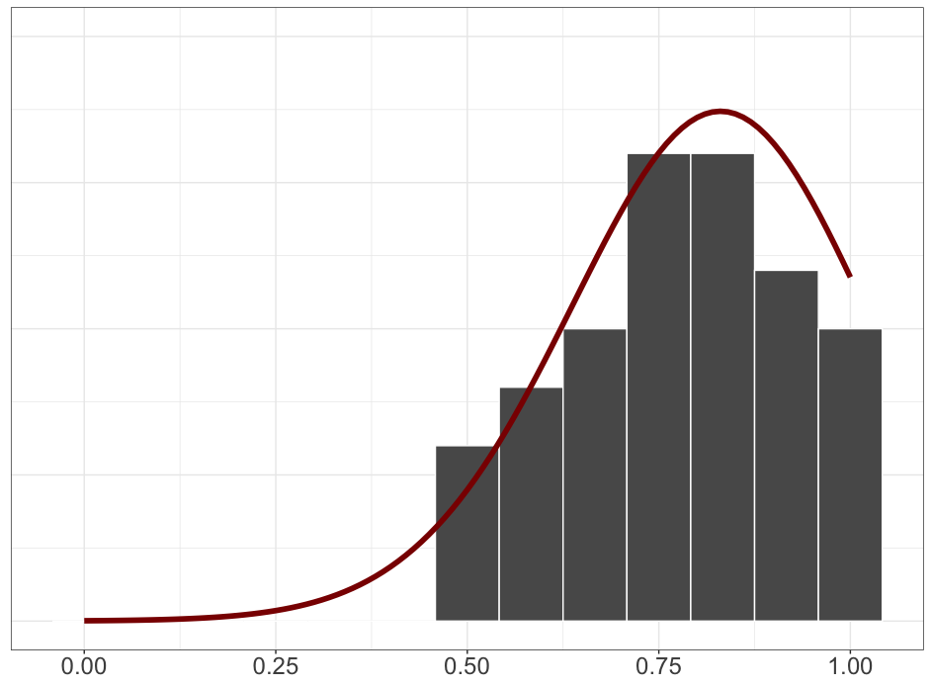
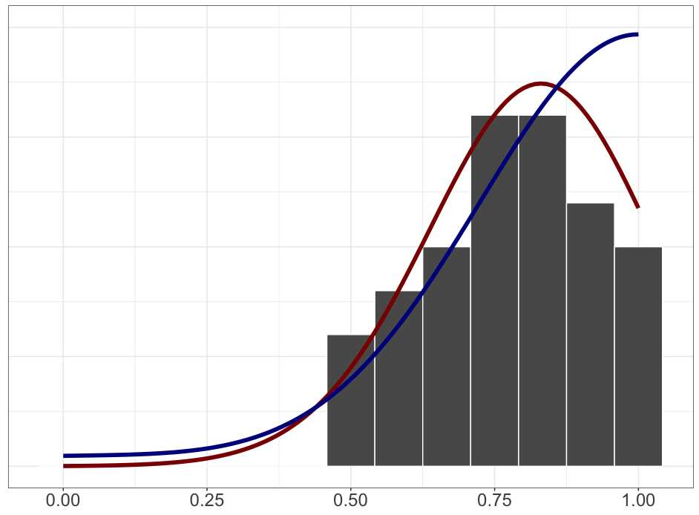

Slide 61
Question #1
Is uncertainty about prior beliefs resolved or unresolved?
Question #2
Is uncertainty about factive inferences resolved or unresolved?

Slide 62
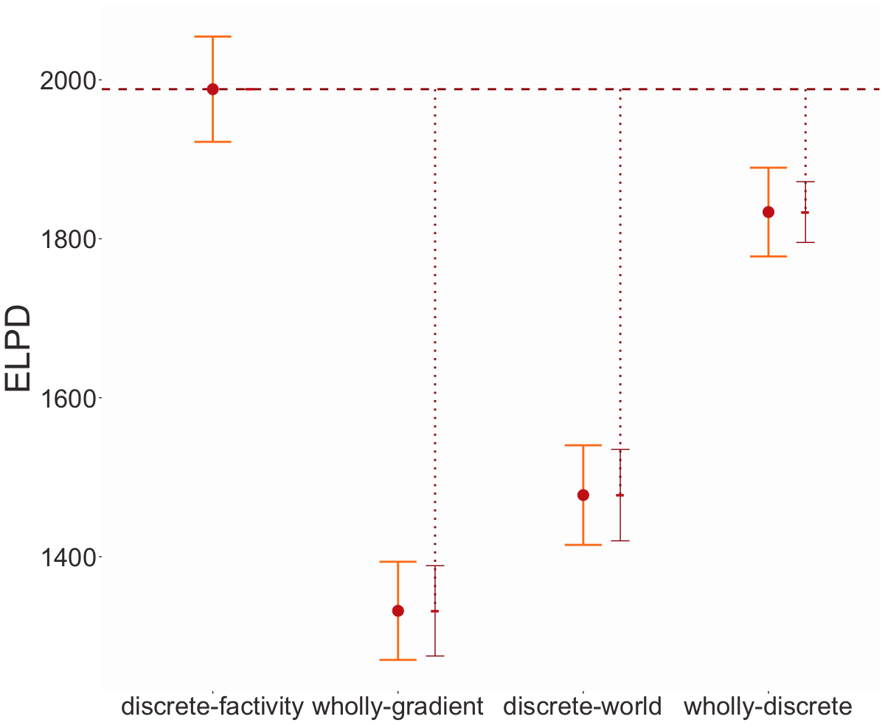
Uncertainty about factive inferences is resolved.
Factivity
Resolved
Factivity
Unresolved
Factivity
Unresolved
Factivity
Resolved

Slide 63
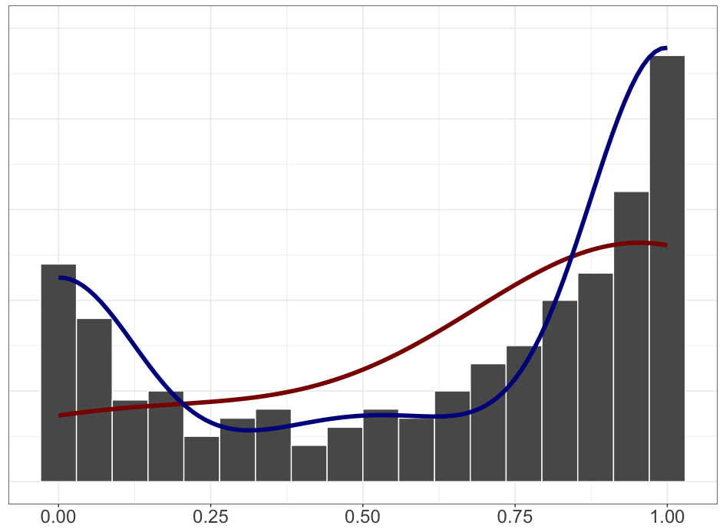
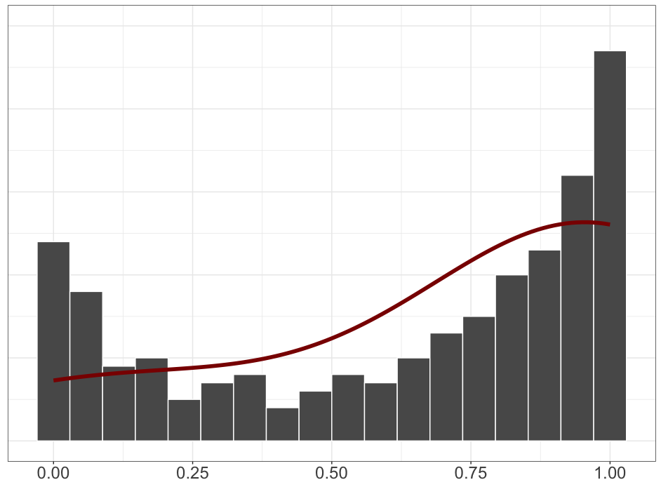
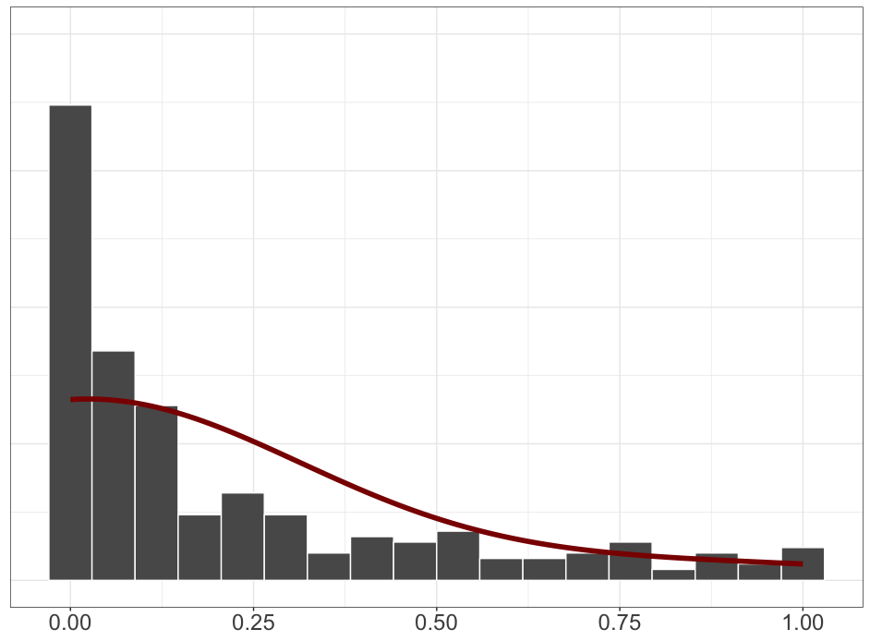
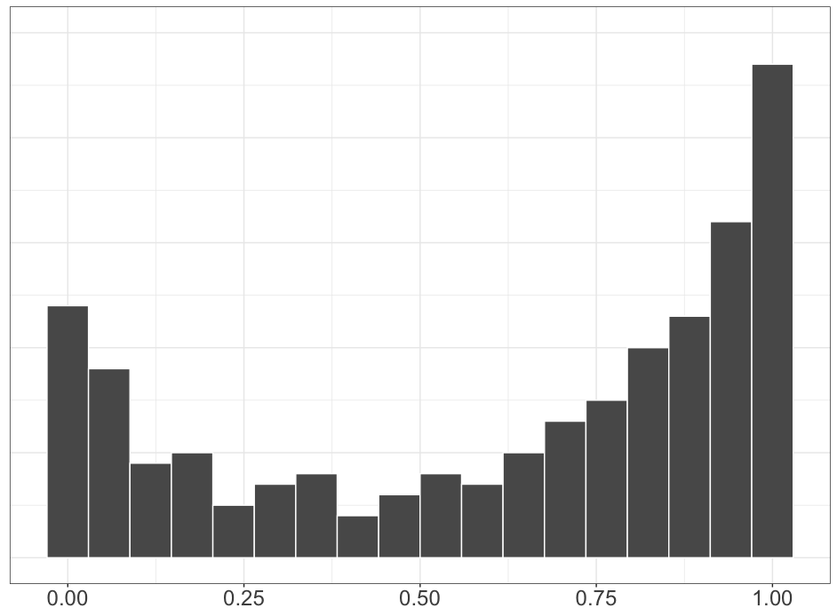
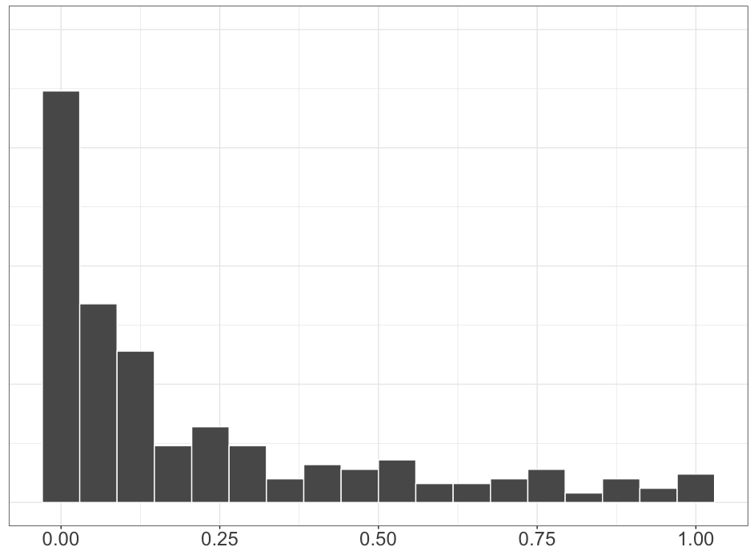
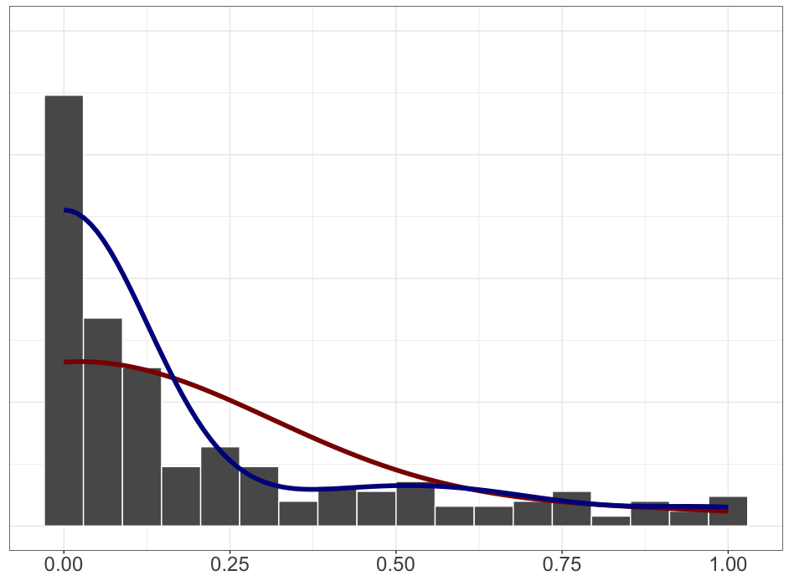
know
pretend

Slide 64
Question #3 see Appendix B
Does the prompt encourage participants to “respond more discretely” because the prompt is a polar question?

Slide 66
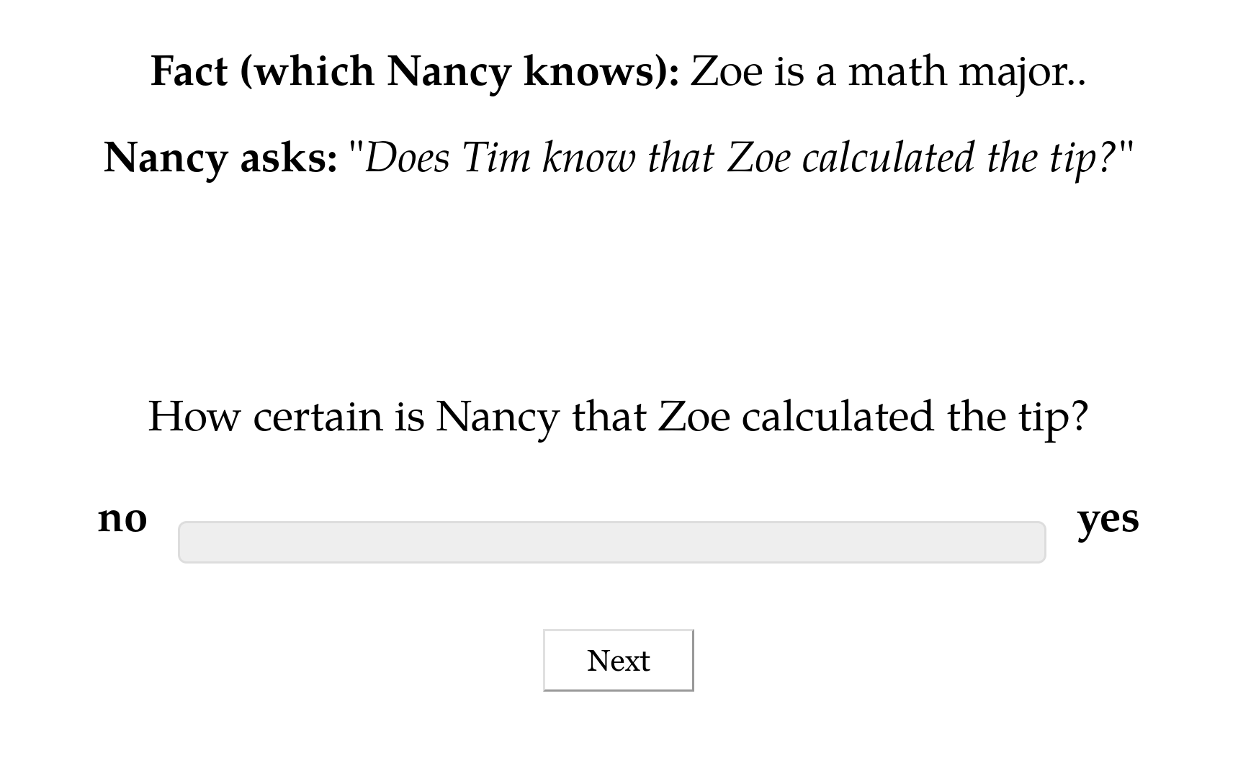

Slide 67
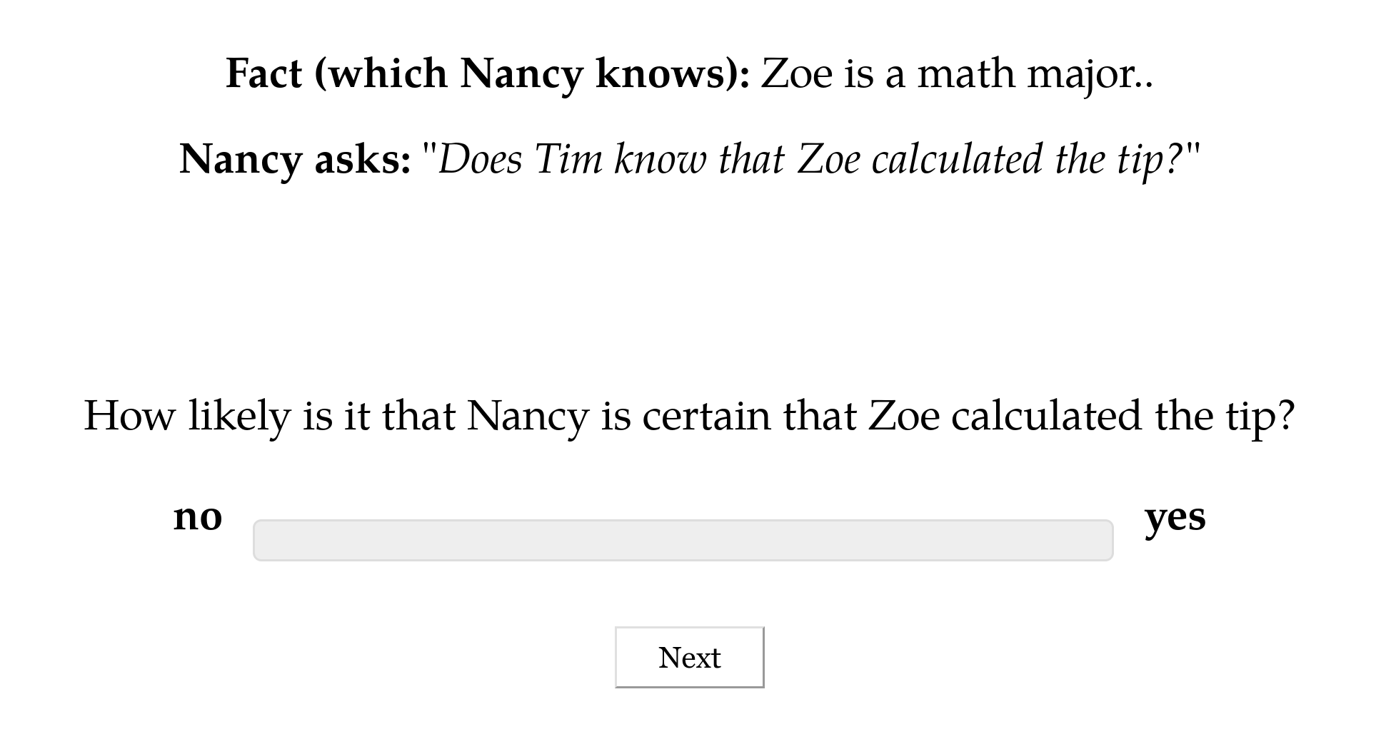

Slide 68
Question #3 see Appendix B
Does the prompt encourage participants to “respond more discretely” because the prompt is a polar question?
Question #4 see Appendix C
Do contents biased for high or low likelihood cause people to “respond more discretely”?

Slide 69
Interim Discussion

Slide 70
Question
Is uncertainty about factive inferences resolved or unresolved?
Answer
Uncertainty in factive inferences is resolved, even though uncertainty about prior beliefs is unresolved.

Slide 71
Semantic + Contextual
Purely Contextual
Ambiguity
Resolved Uncertainty
Uncertainty across multiple distinct semantic values for an expression that have different preconditions of use.
Uncertainty across possible discrete states of a discourse that is resolved as a matter of integrating an utterance.
Uncertainty about the preconditions of use inherent to a single semantic value for an expression evoked on every use.
Vagueness
Uncertainty across possible discrete states of a discourse that is not resolved as a matter of integrating an utterance.
Unresolved Uncertainty

Slide 72
Next Question
Are factive inferences driven by some semantically encoded property (or properties)?
Prediction
If there were such a property or properties, they should…
…show a trace in the inference judgment profiles and…
…that trace should be correlated with distribution.

Slide 73
Predicates don’t appear to cluster!
White & Rawlins 2018, White et al. 2018, Degen and Tonhauser 2022

Slide 74
Possibility #1
Lack of apparent clustering may be due to noise in the measurement.
Possibility #2
Lack of apparent clustering may be due to predicates that are polysemous with respect to factive and nonfactive subclasses of clause-embedding predicates.

Slide 75
It worries Leo that Thea left.
Thea left.
Leo worries that Thea left.

Slide 76
Question
If we develop a model that accounts for measurement noise and the possibility of polysemy, are factive inferences correlated with distribution?

Slide 77
Semantic Encoding

Slide 78
Approach
Induce full classification of clause-embedding lexicon from (i) inference types that clause-embedding predicates are known to vary on; and (ii) a measure of distribution.

Slide 79
Cognitive Nonfactives
Cognitive Semifactives
Positive Emotive Factives
thinks
suspects
knows
realized
likes
is happy
A believes that B happened.
A believes that B happened.
A believes that B happened.
B happened.
A believes that B happened.
A wants B to have happened.
think
suspect
know
realize
doesn’t like
isn’t happy
A doesn’t believes that B happened.
A doesn’t believes that B happened.
A doesn’t believes that B happened.

Slide 80
Approach
Induce full classification of clause-embedding lexicon from (i) inference types that clause-embedding predicates are known to vary on; and (ii) a measure of distribution.
Ensures induced classes are cohesive with respect to both inference and distribution and thus plausibly semantic!

Slide 81
Question
Are any of the induced classes associated with factive inferences (whether they are consistent the prior lit or not)?

Slide 82
Data Component #1
Measure of distribution using acceptability judgments.
Data Component #2
Measure of inferences beyond factive inferences.

Slide 83
Semantic Encoding
Measuring Distribution

Slide 84
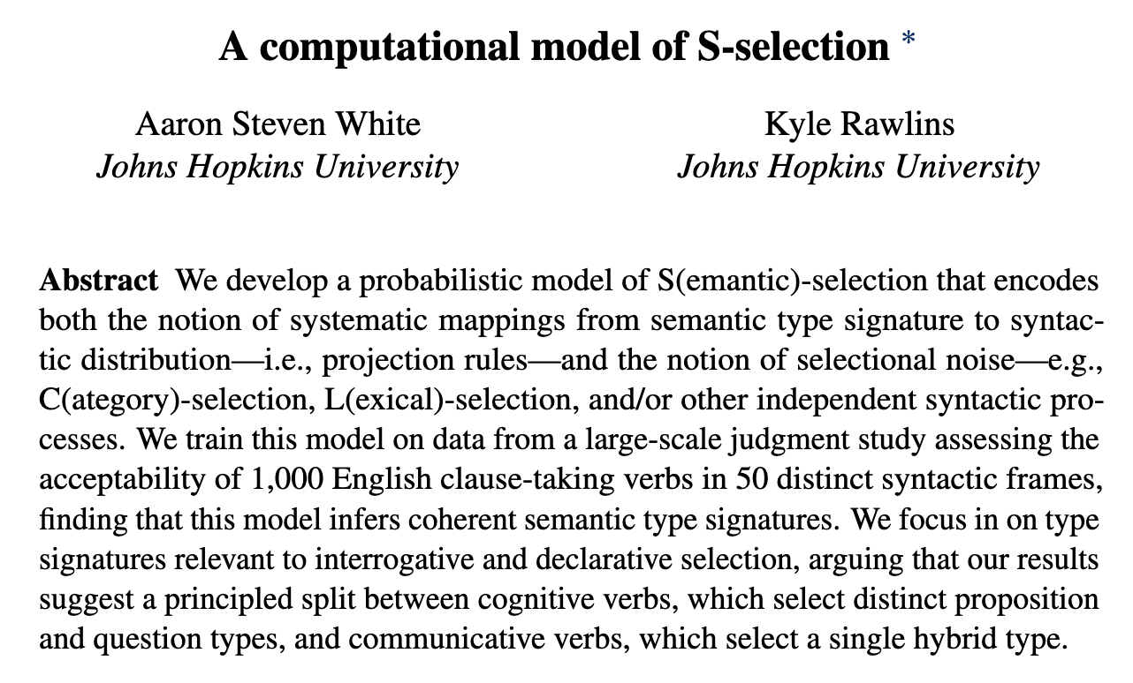
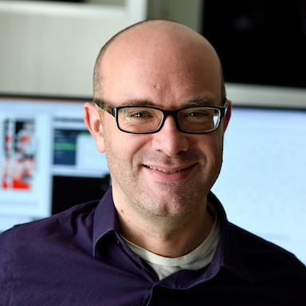
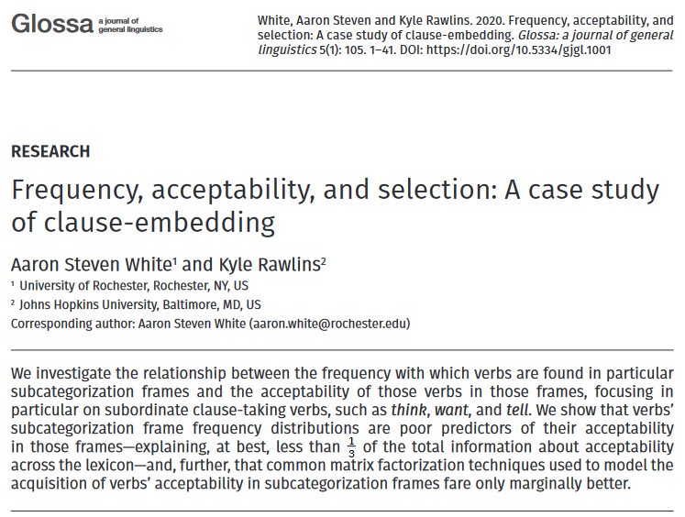
Kyle Rawlins
Johns Hopkins University

Slide 85
MegaAcceptability Dataset
Acceptability for 1,000 verbs in 50 syntactic frames focused on clause-embedding.

Slide 86
Verbs
think
know
wonder
love
surprise
tell
say
start
stop
...

Slide 87
Bleaching Method
Frame templates (e.g. NP __ that S) instantiated by semantically bleached fillers.

Slide 88
Verbs
Frames
think
Someone __ed something happened
know
Someone __ed that something happened
wonder
Someone __ed whether something happened
love
Someone __ed which someone something happened
x
surprise
Someone __ed someone that something happened
tell
Someone __ed someone whether something happened
say
Someone __ed to someone that something happened
start
Someone __ed to do something
stop
Someone __ed someone to do something
...
...

Slide 89
MegaAcceptability Dataset
Acceptability for 1,000 verbs in 50 syntactic frames focused on clause-embedding.
50,000 total items x 5 judgments per item

Slide 90
Question
Is bleaching a valid method for capturing the acceptability of a verb in a frame?

Slide 91
Validation Strategy #1 see Appendix D
Compare judgments for bleached items against judgments from trained linguists.
Validation Strategy #2 see Appendix E
Assess generalization drawn from linguist hand-coding of acceptability across many predicates.

Slide 92
Semantic Encoding
Measuring Inference

Slide 93
Recipe
Validate a bleaching paradigm for collecting judgments for an inference type.
Select a set of frames of interest.
Select predicates acceptable in those frames using MegaAcceptability.
Collect judgments using the paradigm.

Slide 94
Veridicality task

Slide 95
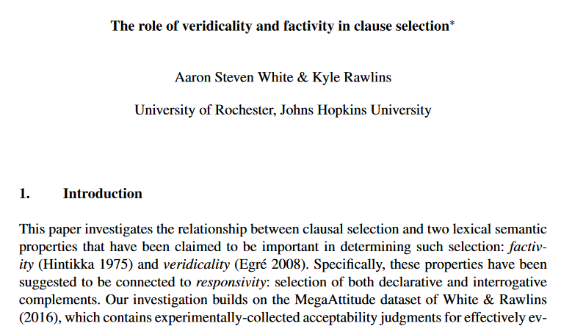
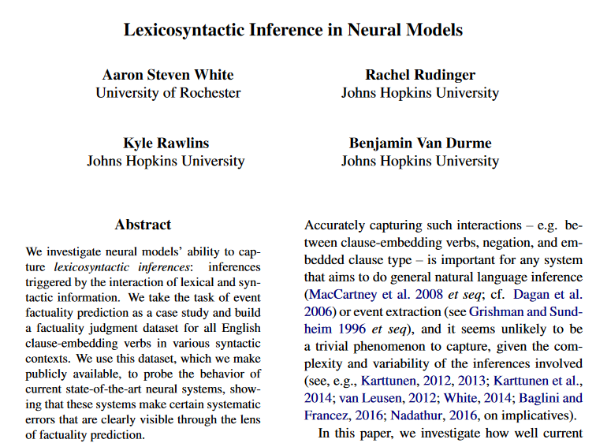
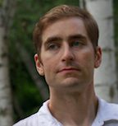
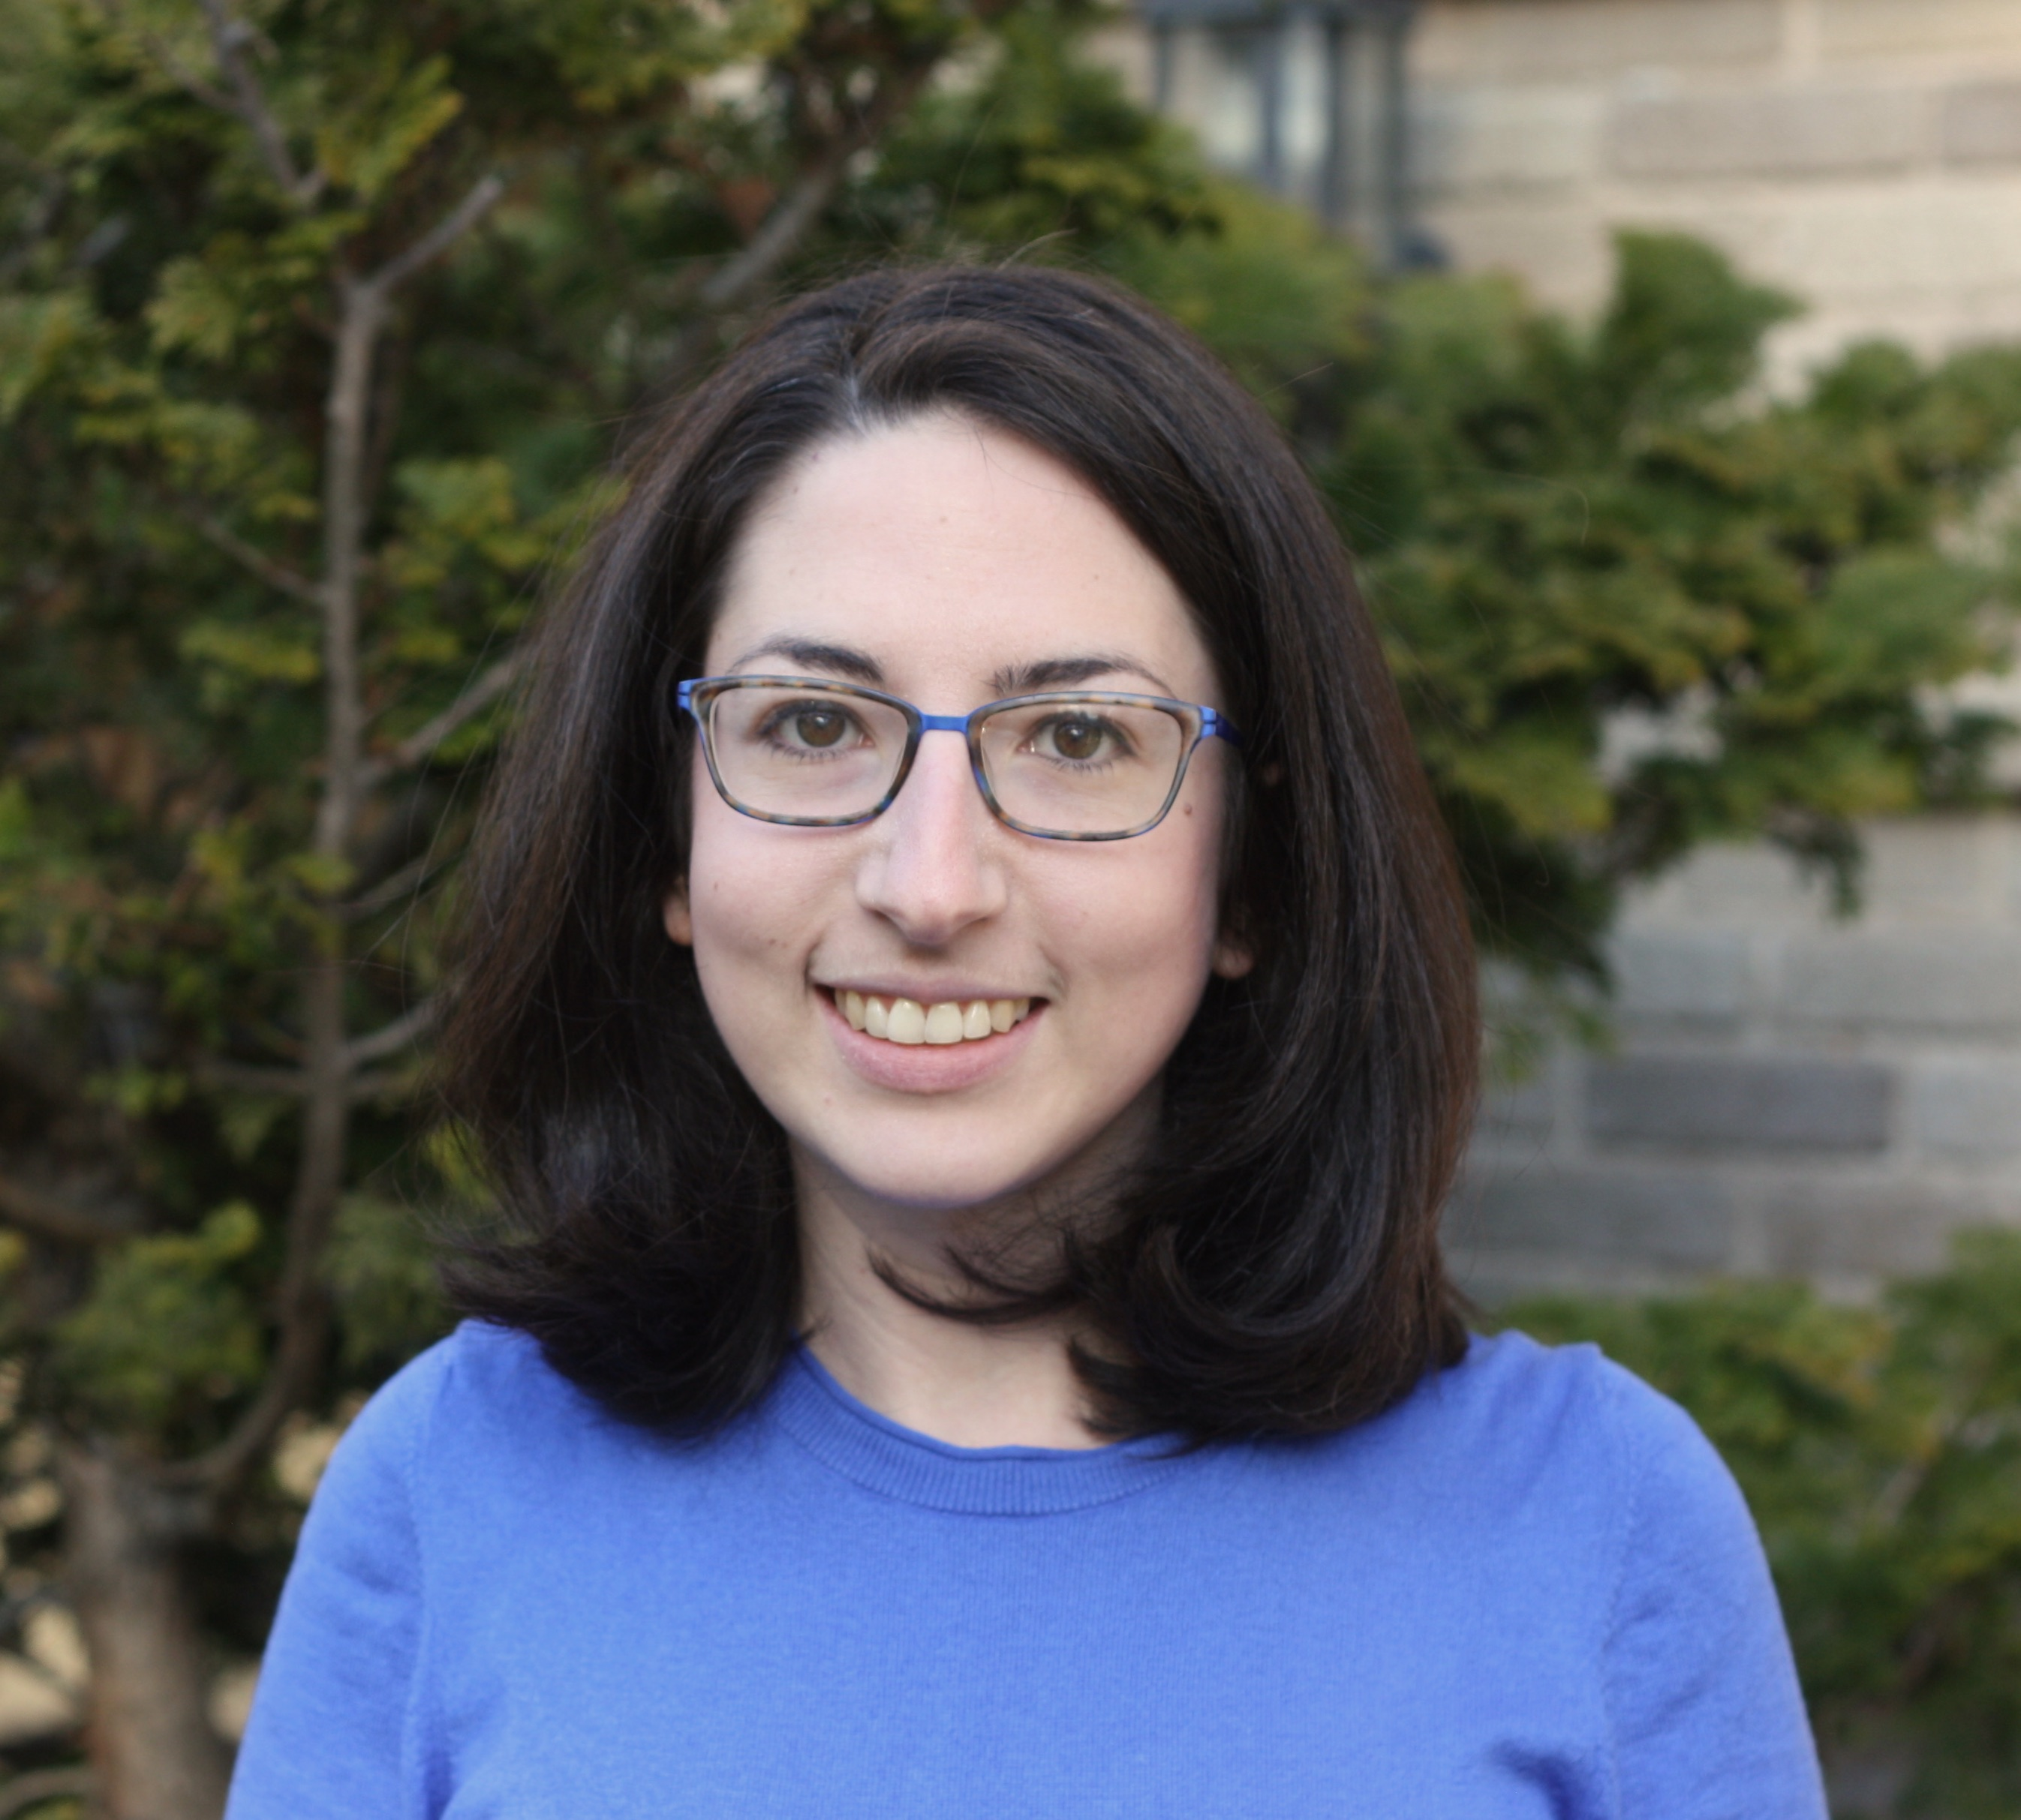
Kyle Rawlins
Johns Hopkins University
Ben Van Durme
Johns Hopkins University
Rachel Rudinger
University of Maryland

Slide 96
Someone was irritated that a particular thing happened.
Veridicality task
Did that thing happen?
no maybe or maybe not yes

Slide 97
NP _ that S
Someone {knew, didn't know} that a particular thing happened.
NP be _ that S
Someone {was, wasn't} surprised that a particular thing happened.
NP _ for NP to VP
Someone {needed, didn’t need} for a particular thing to happen.
NP _ NP to VP[+/-eventive]
Someone {told, didn’t tell} a particular person to do a particular thing.
Someone {believed, didn’t believe} a particular person to have a particular thing.
NP be _ to VP[+/-eventive]
A particular person {was, wasn’t} excited to do a particular thing.
A particular person {was, wasn’t} suspected to have a particular thing.
NP _ to VP[+/-eventive]
A particular person {managed, didn’t manage} to do a particular thing.
A particular person {seemed, didn’t seem} to have a particular thing.

Slide 98
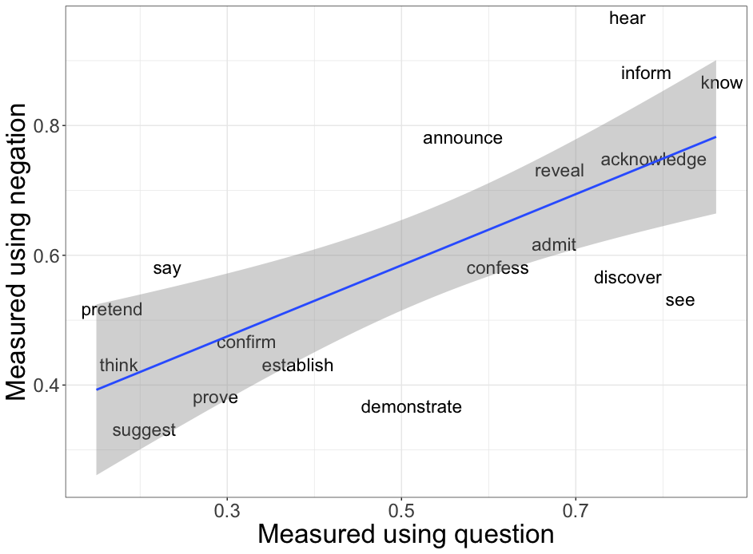
White and Rawlins 2018
r=0.70
Degen and Tonhauser 2018

Slide 99
Belief task

Slide 100
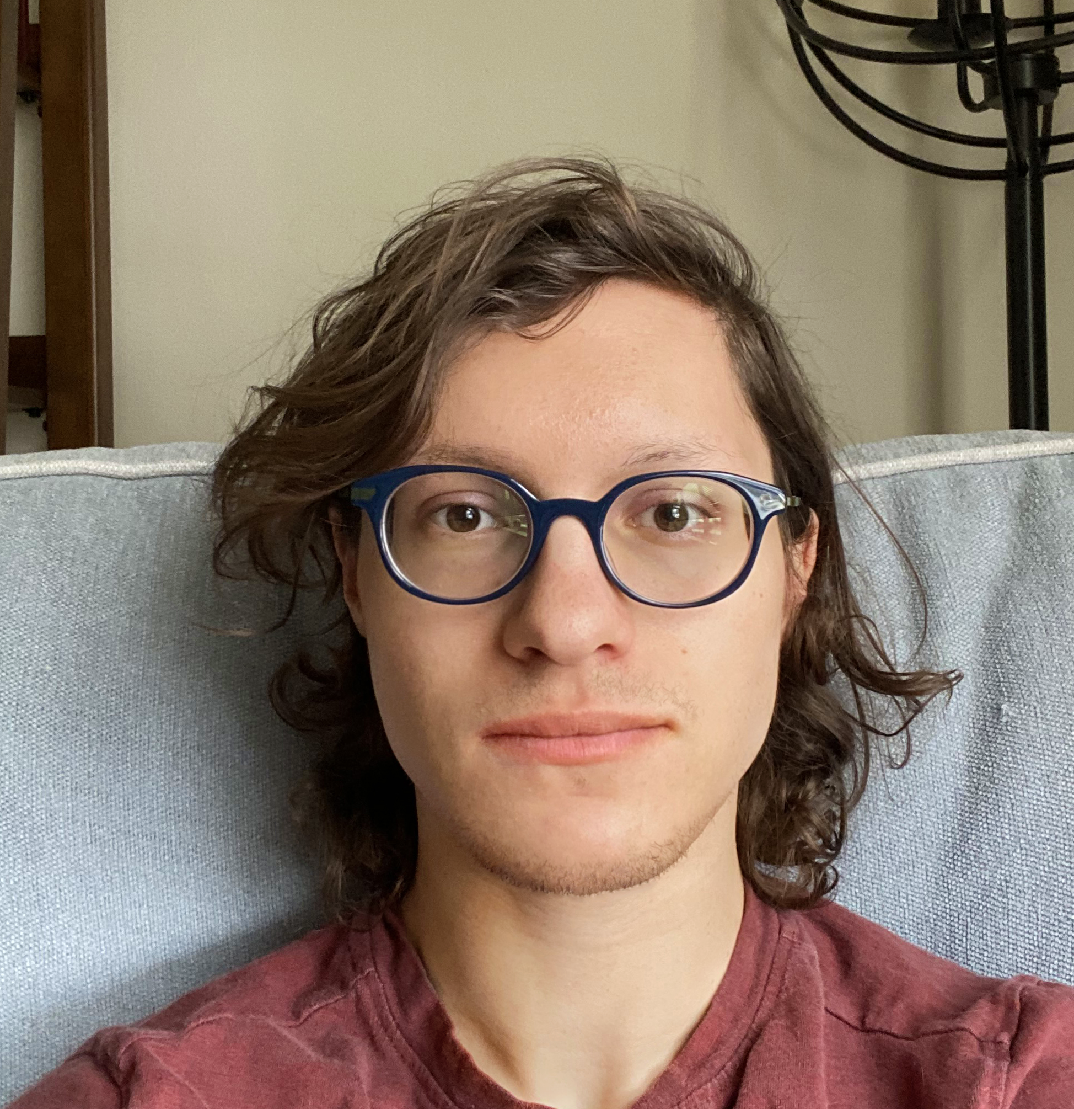
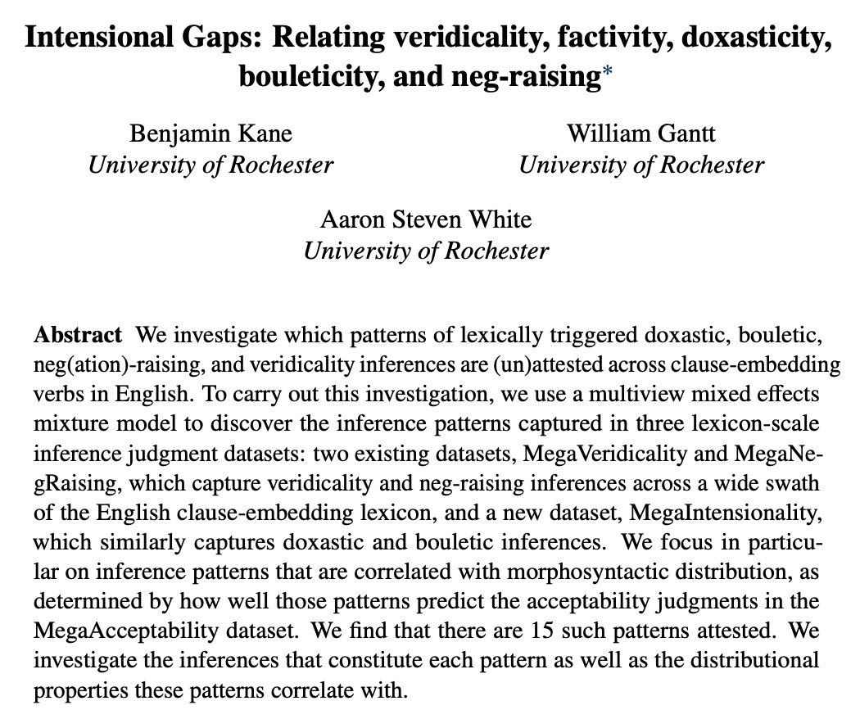
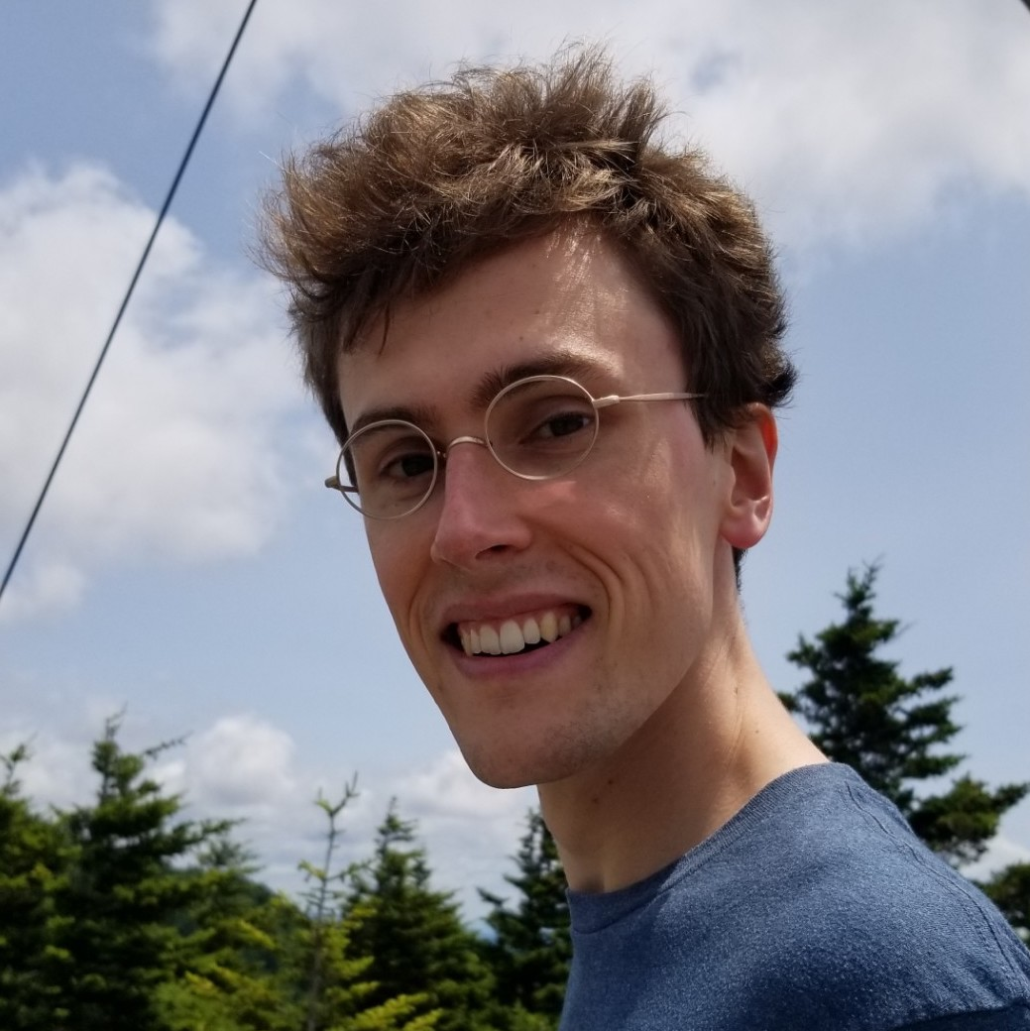
Ben Kane
OpenStream.AI
Will Gantt
Johns Hopkins University

Slide 101
If A knew that C happened, how likely is it that A believed that C happened?
Belief task
Extremely unlikely
Extremely likely

Slide 102
If A persuaded B that C happened, how likely is it that B believed that C happened?
Belief task
Extremely unlikely
Extremely likely

Slide 103
If A was appalled that C happened, how likely is it that A wanted C to have happened?
Desire task
Extremely unlikely
Extremely likely

Slide 104
If A apologized to B that C happened, how likely is it that B wanted C to have happened?
Desire task
Extremely unlikely
Extremely likely

Slide 105
NP _ that S
A {knew, didn't know} that C happened.
NP _ NP that S
A {told, didn't tell} B that C happened.
NP _ to NP that S
A {said, didn't say} to B that C happened.
NP _ that S
A {was, wasn’t} surprised that C happened.
NP _ that S[+future]
A {hoped, didn't hope} that C would happen.
NP _ NP that S[+future]
A {promised, didn't promise} B that C would happen.
NP _ to NP that S[+future]
A {predicted, didn't predict} to B that C would happen.
NP _ that S[+future]
A {was, wasn’t} excited that C would happen.

Slide 106
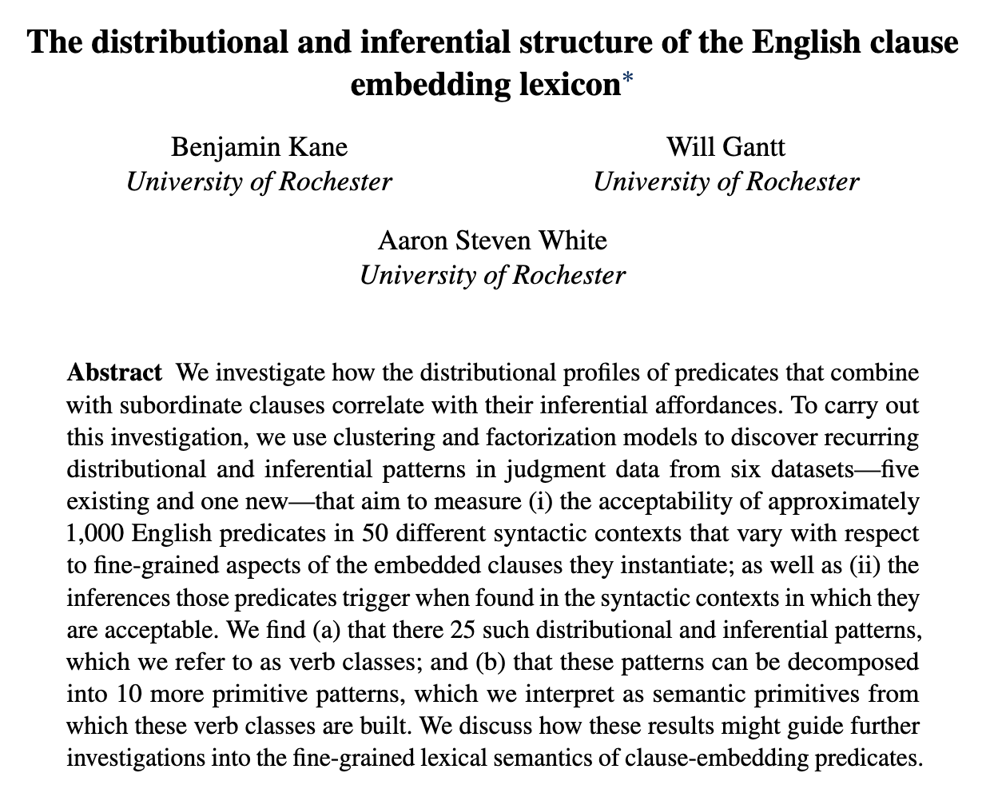
In preparation!
Ben Kane
OpenStream.AI
Will Gantt
Johns Hopkins University

Slide 107
NP _ for NP to VP
A {wanted, didn’t want} for B to do C.
NP _ to VP[+/-eventive]
A {hoped, didn’t hope} to {do, have} C.
NP _ NP to VP[+/-eventive]
A {told, didn't tell} B to {do, have} C.
NP _ to NP to VP[+/-eventive]
A {said, didn't say} to B to {do, have} C.
NP be _ to VP[+/-eventive]
A {was, wasn’t} believed to {do, have} C.
NP _ NP VP
A {saw, didn’t see} B do C.
NP _ VPing
A {liked, didn’t like} doing C.

Slide 108
If A chose to do C, how likely is it that A intended to do C?
Intention task
Extremely unlikely
Extremely likely

Slide 109
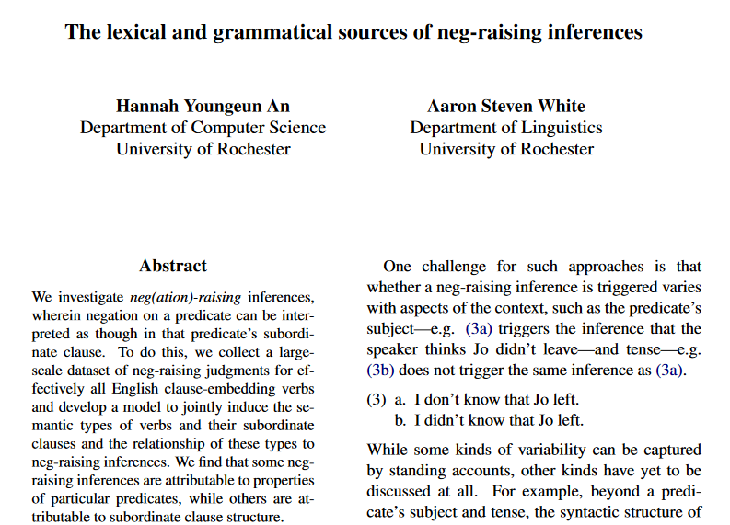
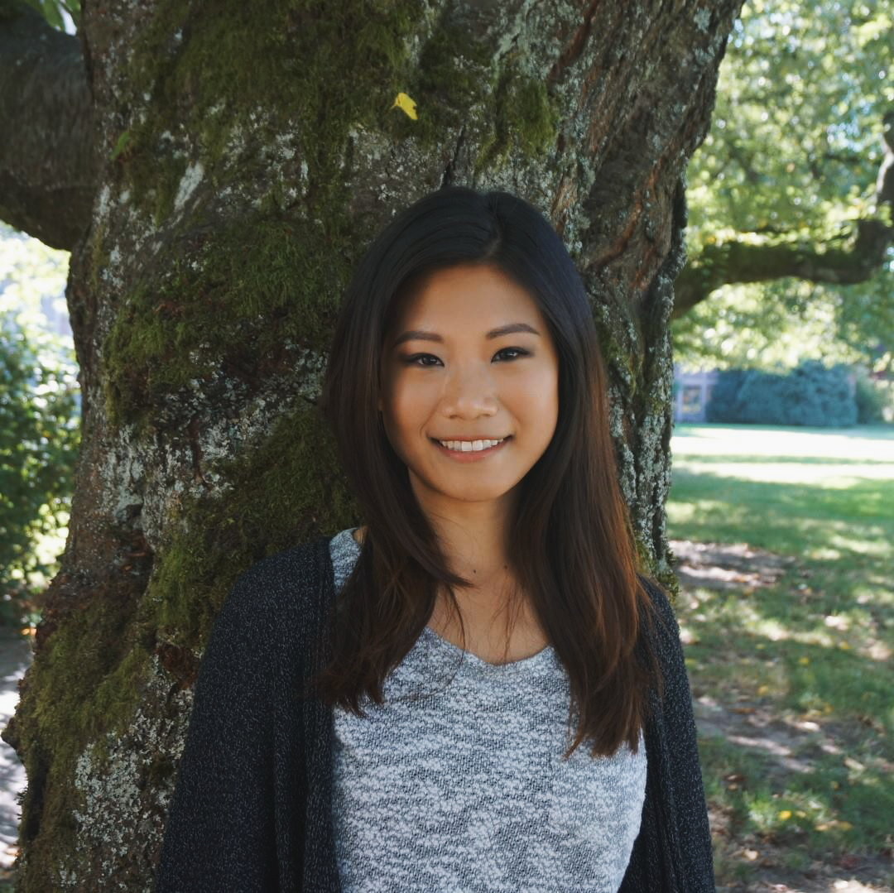
Hannah An
University of Rochester

Slide 110
Neg-raising task

Slide 111
If I were to say I don’t think that a particular thing happened, how likely is it that I mean I think that that thing didn’t happen?
Neg-raising task
Extremely unlikely
Extremely likely

Slide 112
NP _ that S
I {didn’t, don’t}
know that a particular thing happened.
A particular person {didn’t, doesn’t}
NP be _ that S
I {wasn’t, ‘m not}
surprised that a particular thing happened.
A particular person {wasn’t, isn’t}
NP be _ to VP[+/-eventive]
I {wasn’t, ‘m not}
told to do a particular thing.
A particular person {wasn’t, isn’t}
believed to have a particular thing.
NP _ to VP[+/-eventive]
I {didn’t, don’t}
managed to do a particular thing.
A particular person {didn’t, doesn’t}
seemed to have a particular thing.

Slide 113
Question
Is bleaching a valid method for capturing inferences associated with a verb in a frame?

Slide 114
Validation Strategy #1 see Appendix F
Compare judgments for bleached items against judgments from trained linguists.
Validation Strategy #2 see Appendix G
Compare judgments for bleached items to judgments for more contentful items.
Validation Strategy #3 see Appendix H
Compare inference judgments for bleached items to acceptability judgments for distributional diagnostic.

Slide 115
Semantic Encoding
Discovering Patterns

Slide 116
Approach
Cluster predicate-frame pairs in inference space using a multiview mixed effects mixture model.

Slide 117
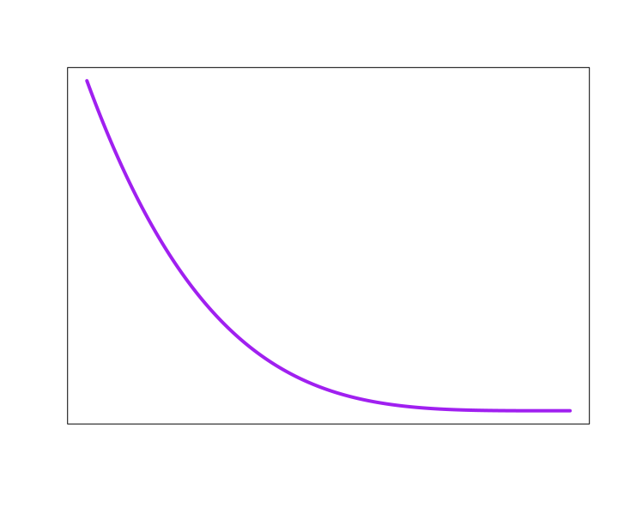
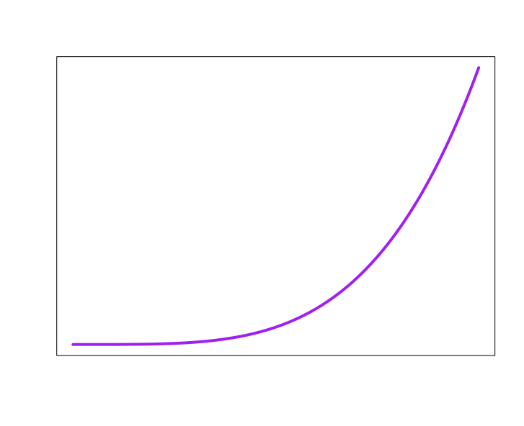

Inference +
distribution patterns
know
NP _ S
1
2
3
4
5
6
10
11
7
8
9
12
Acceptability
Neg-raising
5
4
1
3
6
Belief
2
7
Desire
Intention
Veridicality
NP[3s] not _ S
NP_ S
NP _ S
NP _ S
NP _ S
0
1
0
1
0
1
0
1
no
maybe
yes

Slide 118



Inference +
distribution patterns
know
NP _ S
1
2
3
4
5
6
10
11
7
8
9
12
Acceptability
Neg-raising
5
4
1
3
6
Belief
2
7
Desire
Intention
Veridicality
NP[3s] not _ S
NP_ S
NP _ S
NP _ S
NP _ S
0
1
0
1
0
1
0
1
no
maybe
yes

Slide 119
All frames simultaneously!!!
Inference +
distribution patterns
know
1
2
3
4
5
6
10
11
7
8
9
12
Acceptability
Neg-raising
5
4
1
3
6
Belief
2
7
5
4
Desire
1
3
6
Intention
Veridicality
2
7
5
4
1
3
6
2
7
5
4
1
3
6
2
7
5
4
1
3
6
2
7
0
1
0
1
0
1
0
1
no
maybe
yes
0
1
0
1
0
1
0
1
no
maybe
yes
0
1
0
1
0
1
0
1
no
maybe
yes
0
1
0
1
0
1
0
1
no
maybe
yes
0
1
0
1
0
1
0
1
no
maybe
yes

Slide 120
Method
Fit model to all data in MegaAcceptability, MegaVeridicality, MegaNegRaising, and MegaIntensionality using MAP estimation.

Slide 121
Output
A distribution over inference + distribution patterns for each verb.

Slide 122
Inference +
distribution patterns
know
1
2
3
4
5
6
10
11
7
8
9
12
Acceptability
Neg-raising
5
4
1
3
6
Belief
2
7
5
4
Desire
1
3
6
Intention
Veridicality
2
7
5
4
1
3
6
2
7
5
4
1
3
6
2
7
5
4
1
3
6
2
7
0
1
0
1
0
1
0
1
no
maybe
yes
0
1
0
1
0
1
0
1
no
maybe
yes
0
1
0
1
0
1
0
1
no
maybe
yes
0
1
0
1
0
1
0
1
no
maybe
yes
0
1
0
1
0
1
0
1
no
maybe
yes

Slide 123
Output
A distribution over inference + distribution patterns for each verb.
For each inference pattern, distributions over judgments for each frame and inference type.

Slide 124
Inference +
distribution patterns
know
1
2
3
4
5
6
10
11
7
8
9
12
Acceptability
Neg-raising
5
4
1
3
6
Belief
2
7
5
4
Desire
1
3
6
Intention
Veridicality
2
7
5
4
1
3
6
2
7
5
4
1
3
6
2
7
5
4
1
3
6
2
7
0
1
0
1
0
1
0
1
no
maybe
yes
0
1
0
1
0
1
0
1
no
maybe
yes
0
1
0
1
0
1
0
1
no
maybe
yes
0
1
0
1
0
1
0
1
no
maybe
yes
0
1
0
1
0
1
0
1
no
maybe
yes

Slide 125
Question
How many inference patterns should we assume exist?
Idea
Only as many as we need to predict judgments for verb-frame-judgment type tuples we have not observed when fitting the model.

Slide 126
Implementation
Select the smallest clustering for which no larger clustering improves prediction of held-out tuples.

Slide 127

Likelihood of held out data
# of inference + distribution patterns

Slide 128
Implementation
Select the smallest clustering for which no larger clustering improves prediction of held-out tuples.
Idea
Optimal number of inference + distribution patterns is 25.

Slide 129
Likelihood of head out data
# of inference + distribution patterns

Slide 130
Interpretation
There are at least 25 distributionally correlated inference patterns.
Important Point #1
Not all inference + distribution patterns instantiated by particular predicates will get their own inference pattern.
Important Point #2
Enriching the distributional representation or range of inferences could increase the granularity of the patterns.

Slide 131
Semantic Encoding
Analyzing Patterns

Slide 132
Question
Do we observe subclasses that consistently give rise to factive inferences?
Reason
Observing such subclasses, which are constrained to explain distribution, is consistent with factivity being semantically represented.

Slide 133
Inference +
distribution patterns
Which predicates have high probability for a pattern?
know
1
2
3
4
5
6
10
11
7
8
9
12
Acceptability
Neg-raising
5
4
1
3
6
Belief
2
7
5
4
Desire
1
3
6
Intention
Veridicality
2
7
5
4
1
3
6
2
7
5
4
1
3
6
2
7
5
4
1
3
6
2
7
0
1
0
1
0
1
0
1
no
maybe
yes
0
1
0
1
0
1
0
1
no
maybe
yes
0
1
0
1
0
1
0
1
no
maybe
yes
0
1
0
1
0
1
0
1
no
maybe
yes
0
1
0
1
0
1
0
1
no
maybe
yes

Slide 134
What is the expected value of each distribution?
Inference +
distribution patterns
know
1
2
3
4
5
6
10
11
7
8
9
12
Acceptability
Neg-raising
5
4
1
3
6
Belief
2
7
5
4
Desire
1
3
6
Intention
Veridicality
2
7
5
4
1
3
6
2
7
5
4
1
3
6
2
7
5
4
1
3
6
2
7
0
1
0
1
0
1
0
1
no
maybe
yes
0
1
0
1
0
1
0
1
no
maybe
yes
0
1
0
1
0
1
0
1
no
maybe
yes
0
1
0
1
0
1
0
1
no
maybe
yes
0
1
0
1
0
1
0
1
no
maybe
yes

Slide 135
Names given by analyst based on manual analysis!
Inference +
distribution patterns
know
1
2
3
4
5
6
10
11
7
8
9
12
Acceptability
Neg-raising
5
4
1
3
6
Belief
2
7
5
4
Desire
1
3
6
Intention
Veridicality
2
7
5
4
1
3
6
2
7
5
4
1
3
6
2
7
5
4
1
3
6
2
7
0
1
0
1
0
1
0
1
no
maybe
yes
0
1
0
1
0
1
0
1
no
maybe
yes
0
1
0
1
0
1
0
1
no
maybe
yes
0
1
0
1
0
1
0
1
no
maybe
yes
0
1
0
1
0
1
0
1
no
maybe
yes

Slide 136

Purely for exposition!
Derived by hierarchical clustering based on expected value of inference distributions.

Slide 137
Plan
Walk through some classes we might expect and show that they look exactly like we would expect them to.

Slide 138
discover, realize, recognize, know, find out, understand, …

Slide 140
discovered
realized
recognized
knew
…
Someone that a particular thing happened.
That thing happened.

Slide 141
discover
realize
recognize
know
…
Someone didn’t that a particular thing happened.
That thing happened.

Slide 143


Slide 144
discovered
realized
recognized
knew
…
Someone that something happened.

Slide 145
discovered
realized
recognized
knew
…
*Someone was that something happened.

Slide 146
dream, hope, think, agree, assume, …

Slide 147
dreamed hoped
thought assumed
…
Someone (*was) that something happened.

Slide 148
dream
hope
think assume
…
Someone did(n’t) that a particular thing happened.
x
That thing happened.

Slide 149

discovered
realized
recognized
knew
…
A that C happened.
A believed that C happened.

Slide 150
discover
realize
recognize
know
…
A didn’t that C happened.
x
A believed that C happened.

Slide 151
dreamed
hoped
thought assumed
…
A that C happened.
A believed that C happened.

Slide 152
be contented, be relieved, be amused, be charmed, be pleased, be comforted, …

Slide 153
pleased
relieved
amused
charmed
…
Someone was(n’t) that a particular thing happened.
That thing happened.

Slide 154
pleased
relieved
amused
charmed
…
A was(n’t) that C happened.
A believed that C happened.

Slide 155

pleased
relieved
amused
charmed
…
A was that C happened.
A wanted C to have happened.

Slide 156
pleased
relieved
amused
charmed
…
A wasn’t that C happened.
x
A wanted C to have happened.

Slide 157
Upshot
We observe classes that recapitulate part of the standard classification of clause-embedding predicates.

Slide 158
Interim Discussion

Slide 159
Question
If we develop a model that accounts for measurement noise and the possibility of multiple subclasses, are factive inferences correlated with distribution?
Answer
Yes.

Slide 160
Upshot
This correlation is consistent with the drivers of factive inferences being semantically represented.

Slide 161
Semantic + Contextual
Purely Contextual
Ambiguity
Resolved Uncertainty
Uncertainty across multiple distinct semantic values for an expression that have different preconditions of use.
Uncertainty across possible discrete states of a discourse that is resolved as a matter of integrating an utterance.
Uncertainty about the preconditions of use inherent to a single semantic value for an expression evoked on every use.
Vagueness
Uncertainty across possible discrete states of a discourse that is not resolved as a matter of integrating an utterance.
Unresolved Uncertainty

Slide 162
Important Point #1
The relationship between the semantic drivers and the factive inferences may be indirect.

Slide 163
Cognitive Nonfactives
Cognitive Semifactives
Positive Emotive Factives
thinks
suspects
knows
realized
loves
likes
A believes that B happened.
A believes that B happened.
A believes that B happened.
B happened.
A believes that B happened.
A wants B to have happened.
think
suspect
know
realize
love
like
A doesn’t believes that B happened.
A doesn’t believes that B happened.
A doesn’t believes that B happened.

Slide 164
Positive Emotive Factives
loves
likes
A believes that B happened.
B happened.
A believes that B happened.
A wants B to have happened.
love
like
A doesn’t believes that B happened.

Slide 165
Positive Emotive Factives
loves
likes
A believes that B happened.
Default credence inference?
Heim 1992, Djarv et al. 2018
B happened.
A believes that B happened.
A wants B to have happened.
Still a lexically encoded precondition of use!
love
like
A doesn’t believes that B happened.

Slide 166
Important Point #1
The relationship between the semantic drivers and the factive inferences may be indirect.
Important Point #2
The information the predicate provides may be purely formal–e.g. predicates may select morphemes that themselves drive factive inferences.

Slide 167






Factivity is strongly linked with a variety of morphemes that mediate the relationship between the embedding predicate and the embedded clause!
among others…

Slide 168
Important Point #3
Purely contextual account may still be possible, but it should explain why the distributional correlations exists.
see Roberts and Simons 2024
Important Point #4
As always, we still need a pragmatic story for how we determine what linguistic expression is being used.

Slide 169
Conclusion

Slide 170
Big Question
What kinds of things do we know when we know the meaning (broadly construed) of a linguistic expression?

Slide 171
One Kind of Knowledge
How the expression can move a conversation forward when used in a particular way.
???
Another Kind of Knowledge
How the conversation has to look for it to even make sense to use the expression.

Slide 172
This Talk
Expressions carry information about preconditions of use in their semantics.
Open class items are (part of) the locus of this information.

Slide 173
Question
Why would we see predicates semantically (or at least distributionally) encoding their preconditions of use?
Possible Answer
It might be very hard to learn these preconditions otherwise.

Slide 174

Simply tracking the discourse status of the embedded clause content is unlikely to work!

Slide 175
Thanks!

Slide 176

Supported by NSF-BCS-1748969
The MegaAttitude Project: Investigating selection and polysemy at the scale of the lexicon

Slide 177
Appendix A
Posterior distributions

Slide 178

Posterior distribution of mean response

Slide 179
Appendix B
Prompt manipulation

Slide 180
Question #3
Does the prompt encourage participants to “respond more discretely” because the prompt is a polar question?

Slide 182
Question #3
Does the prompt encourage participants to “respond more discretely” because the prompt is a polar question?
Approach
Modify the prompt to query for the level of likelihood or certainty the speaker has.

Slide 184


Slide 188


Slide 189
Appendix C
Content manipulation

Slide 190
Question #4
Do contents biased for high or likelihood cause people to “respond more discretely”?
Approach
Remove the possibility that people can rely on prior beliefs by bleaching the content of the sentence.

Slide 191


Slide 192


Slide 193


Bleached
Templatic

Slide 194


Slide 195
Appendix D
Acceptability Validation #1

Slide 196
Validation data
Select 30 verbs from across Hacquard & Wellwood's (2012) classification
Gather judgments for these verbs in all 50 syntactic frames from:
trained linguists
naïve speakers

Slide 197
Comparison
Correlation between judgments from LI and Sprouse et al.'s (2013) dataset

Slide 198

Correlation
Sprouse Linguistic Inquiry
MegaAcceptability

Slide 199
Appendix E
Acceptability Validation #2

Slide 200
Case Study The vast majority of about-PPs are adjuncts.
Rawlins 2013, 2014

Slide 201
XP₁ V (XP₂) (XP₃) about XP₄
is acceptable
X
XP₁ V (XP₂) (XP₃)
is acceptable

Slide 202


NP _ed about XP
NP _ed

Slide 203

Rawlins 2014

Slide 204

NP _ed about XP
NP _ed

Slide 205

NP _ed about XP
NP _ed

Slide 206

NP _ed about XP
NP _ed

Slide 207

NP _ed about XP
NP _ed

Slide 208

NP _ed about XP
NP _ed

Slide 209

NP _ed about XP
NP _ed

Slide 210

Independence
Proportion violations
Noise variance / acceptability variance

Slide 211
Independence
Proportion violations
Noise variance / acceptability variance

Slide 212

NP (was) _ed about whether S
NP (was) _ed

Slide 213

NP (was) _ed about whether S
NP (was) _ed

Slide 214

NP (was) _ed about whether S
NP (was) _ed

Slide 215

NP (was) _ed about whether S
NP (was) _ed

Slide 216

Proportion violations
Acceptability threshold

Slide 217
Independence
Proportion violations
Noise variance / acceptability variance

Slide 218
Proportion violations
Acceptability threshold

Slide 219
Proportion violations
Acceptability threshold

Slide 220
Appendix F
Inference Validation #1

Slide 221
 | Neg-raising | Non-neg-raising
NP __ that S | think, believe, feel, reckon, figure, guess, suppose, imagine | announce, claim, assert, report, know, realize, notice, find out
NP __ to VP | want, wish, happen, seem, plan, intend, mean, turn out | love, hate, need, continue, try, like, desire, decide

Slide 222


Mean rating of bleached example
Non-neg-raising
Neg-raising

Slide 223
Appendix G
Inference Validation #2

Slide 224
Implementation
For each verb-frame pair in validation set, sample five items from corpus.

Slide 225

Mean rating of bleached example
r = 0.8
(p < 0.001)
Mean rating of corpus example

Slide 226
Appendix E
Inference Validation #3

Slide 227
Implementation
For each verb-frame pair in validation set, collect acceptability of strong NPI (additive either).
Jo didn’t do a particular thing, and…
…I don’t think that Bo did that thing either.
…I think that Bo didn’t do that thing either.

Slide 228

Mean acceptability of strong NPI
r = 0.77
(p < 0.001)
Mean rating of bleached example

Slide 229
Appendix H
Inference Validation #3

Slide 230
Implementation
For each verb-frame pair in validation set, collect acceptability of strong NPI (additive either).
Jo didn’t do a particular thing, and…
…I don’t think that Bo did that thing either.
…I think that Bo didn’t do that thing either.

Slide 231
Mean acceptability of strong NPI
r = 0.77
(p < 0.001)
Mean rating of bleached example

Slide 232
Appendix I
Predicates in each class

Slide 233
glare, grin, strut, talk, beam, frown, scowl, sulk, …

Slide 234
hound, pester, educate, interview, badger, brief, bug, challenge, …

Slide 235
bury, come, function, happen, invite, result, …

Slide 236
inform, remind, tell, advise, alert, ask, email, notify, warn, …

Slide 237
audit, discipline, approach, chastise, compliment, praise, demean, …

Slide 238
be fazed, be clouded, be gladdened, be affronted, be bored, be blessed, chide, …

Slide 239
defend, imitate, portray, address, conceal, depict, describe, detail, …

Slide 240
buy, delete, alter, attempt, insert, operate, cause, …

Slide 241
coerce, enlist, manipulate, allow, assign, bribe, coax, compel, force, …

Slide 242
articulate, communicate, explain, write, …

Slide 243
affirm, confirm, verify, acknowledge, clarify, …

Slide 244
be contented, be relieved, be amused, be charmed, be pleased, be comforted, …

Slide 245
check, investigate, contemplate, evaluate, examine, explore, …

Slide 246
aim, appear, compete, hunger, try, lust, attempt, start, …

Slide 247
expect, authorize, desire, request, allow, approve, …

Slide 248
dream, hope, think, agree, assume, …

Slide 249
discover, realize, recognize, know, find out, understand, …

Slide 250
manage, glean, opt, presuppose, signify, conclude, …

Slide 251
apologize, complain, cry, gloat, growl, sob, weep, …

Slide 252
(be) depress(ed), (be) disappoint(ed), (be) shock(ed), (be) disgust(ed), (be) displease(ed), (be) embarrass(ed), (be) frustrate(ed), (be) surprise(ed), …

Slide 253
confuse, distress, freak out, panic, perplex, puzzle, stump, baffle, …

Slide 254
fret, lie, agonize, bitch, brood, object, quarrel, quibble, whine, …

Slide 255
decline, fail, hate, neglect, refuse, regret, detest, dislike, …

Slide 256
denounce, disallow, face, prohibit, repress, abhor, admonish, …

Slide 257
doubt, question, dispute, fear, neglect, worry, …

Slide 258
Appendix J
Class-frame relationship

Slide 259
Simple past matrix

Slide 260

Simple present matrix

Slide 261
Past progressive matrix

Slide 262
Appendix K
Class-constituent relationship

Slide 263


Slide 264
Appendix L
Class-inference relationships

Slide 270
Appendix M
Class-primitive relationships

Slide 271


Slide 272
Appendix N
Primitive-constituent relationships

